Slide 1
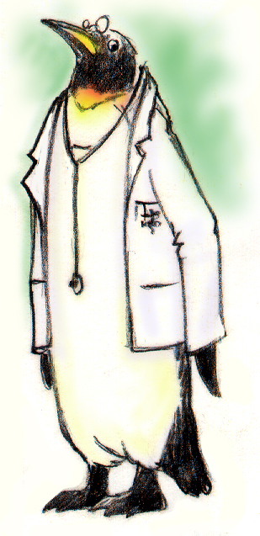
Leading Teams

Slide 2
Objectives
Describe how leadership affects team processes and outcomes
Identify different types of team leaders
Describe the activities involved in successfully leading teams
Describe the tools for leading teams, including briefs, huddles, and debriefs
Apply the tools for leading teams to specific clinical scenarios

Slide 3
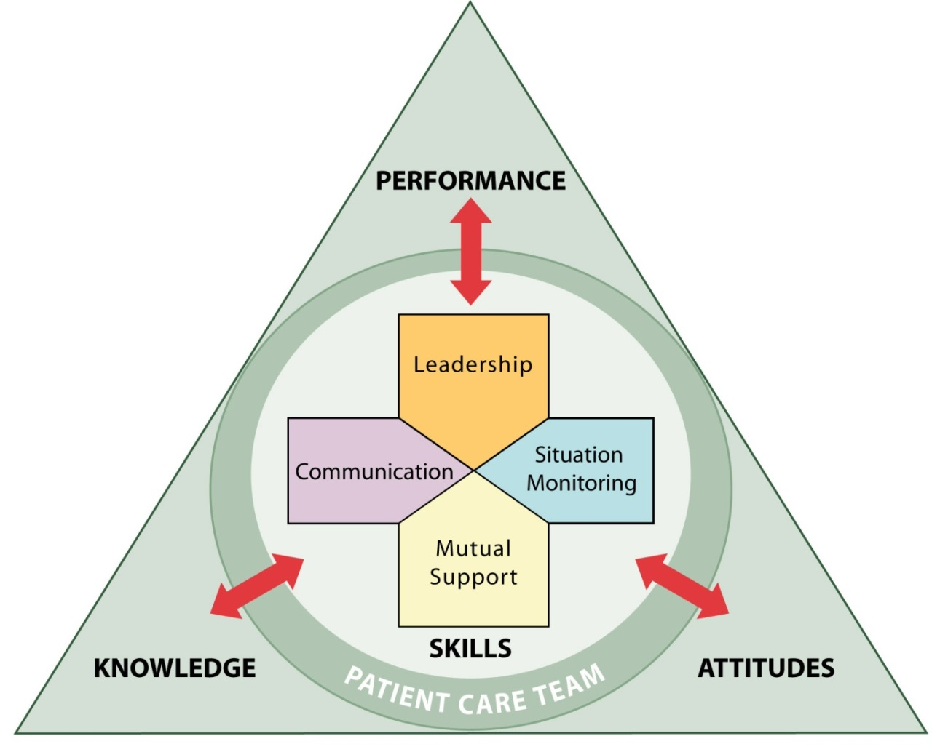
Leadership
Holds a teamwork system together
Ensures a plan is conveyed, reviewed, and updated
Facilitated through communication, continuous monitoring of the situation, and fostering of an environment of mutual support

Slide 4
Effective Team Leaders
Define, assign, share, monitor, and modify a plan
Review the team’s performance
Establish “rules of engagement”
Manage and allocate resources effectively
Provide feedback regarding assigned responsibilities and progress toward the goal
Facilitate information sharing
Encourage team members to assist one another
Facilitate conflict resolution
Model effective teamwork

Slide 5
Types of Team Leaders
Designated – The person assigned to lead and organize a team, establish clear goals, and facilitate open communication and teamwork among team members
Situational – Any team member who has the skills to manage the situation at hand

Slide 6
Effective Leadership?
Video: High & Mighty

Slide 7
Briefs
A team briefing is an effective strategy for sharing the plan
Briefs should help:
Form the team
Designate team roles and responsibilities
Establish climate and goals
Engage team in short- and long-term planning
Video: Brief

Slide 8
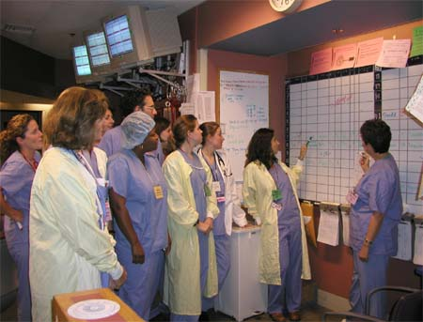
Briefing Checklist Tool
TOPIC
Who is on core team?
All members understand and agree upon goals?
Roles and responsibilities understood?
Plan of care?
Staff availability?
Workload?
Available resources?

Slide 9
Huddle
Problem Solving
Hold ad hoc, “touch base” meetings to regain situation awareness
Discuss critical issues and emerging events
Anticipate outcomes and likely contingencies
Assign resources
Express concerns

Slide 10
Huddle

Slide 11
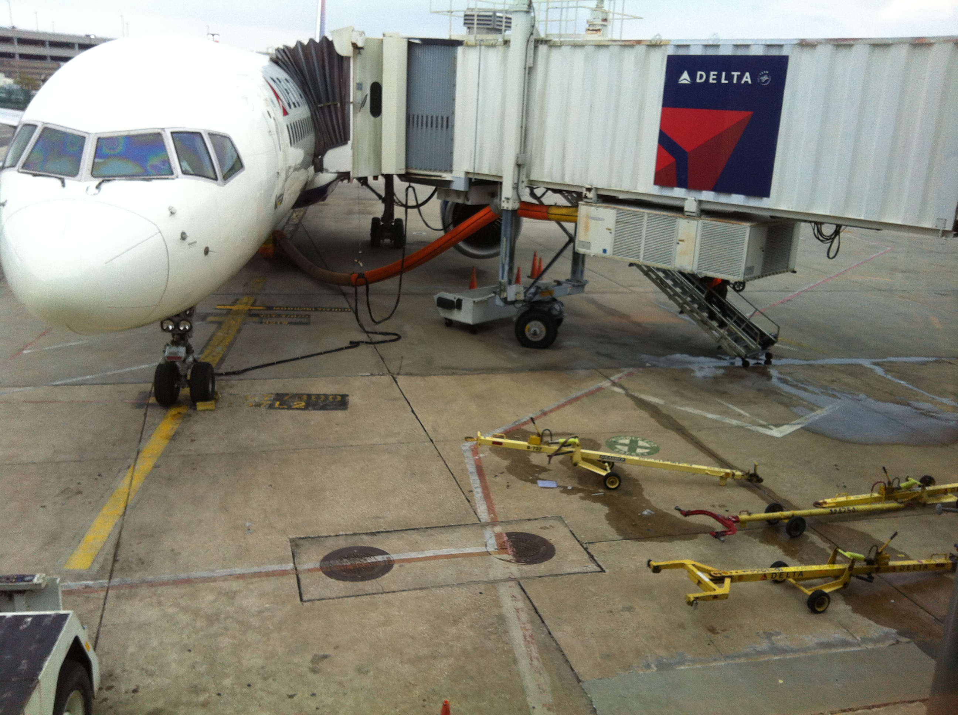
Check This Out

Slide 12
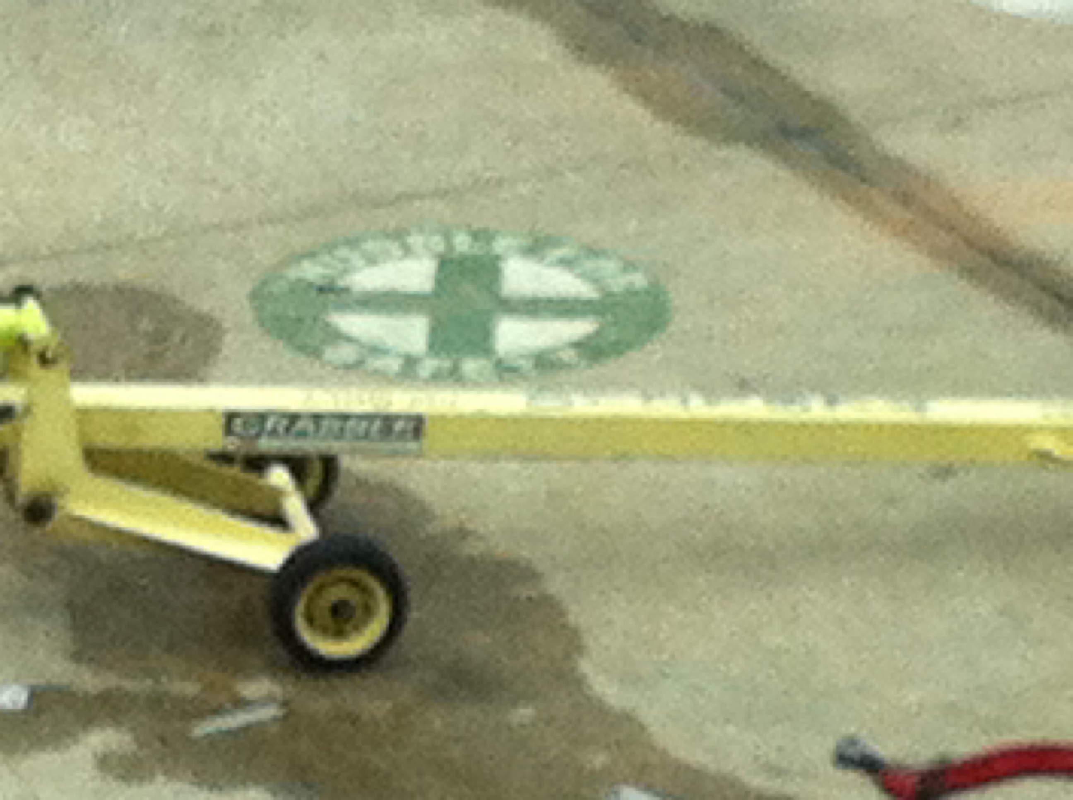
“HUDDLE FOR SAFETY”
PAINTED ON THE TARMAC AT NEW ORLEANS AIRPORT

Slide 13
Debrief
Process Improvement
Brief, informal information exchange and feedback sessions
Occur after an event or shift
Designed to improve teamwork skills
Designed to improve outcomes
An accurate recounting of key events
Analysis of why the event occurred
Discussion of lessons learned and reinforcement of successes
Revised plan to incorporate lessons learned

Slide 14
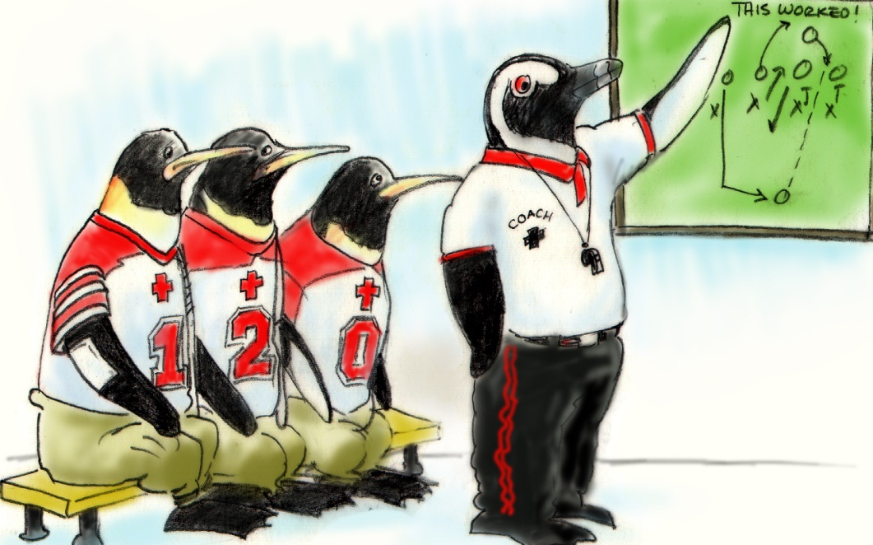
Debrief Checklist
TOPIC
Communication clear?
Roles and responsibilities understood?
Situation awareness maintained?
Workload distribution?
Did we ask for or offer assistance?
Were errors made or avoided?
What went well, what should change, what can improve?

Slide 15
Leadership Skills: Facilitating Conflict Resolution
Effective leaders:
Facilitate conflict resolution to avoid compromising patient safety and quality of care
Do not allow interpersonal or irrelevant issues to negatively affect the team
Help team members master conflict resolution techniques

Slide 16
Leadership Skills: Promoting & Modeling Teamwork
Effective leaders cultivate desired team behaviors and skills through:
Open sharing of information
Role modeling and effective cuing of team members to use prescribed teamwork behaviors and skills
Constructive and timely feedback
Facilitation of briefs, huddles, debriefs, and conflict resolution
Mitigation of conflict within the team

Slide 17
Tools & Strategies Summary
BARRIERS
Inconsistency in Team Membership
Lack of Time
Lack of Information Sharing
Hierarchy
Defensiveness
Conventional Thinking
Complacency
Varying Communication Styles
Conflict
Lack of Coordination and Followup With Coworkers
Distractions
Fatigue
Workload
Misinterpretation of Cues
Lack of Role Clarity
TOOLS and STRATEGIES
Communication
SBAR
Call-Out
Check-Back
Handoff
Leading Teams
Brief
Huddle
Debrief
OUTCOMES
Shared Mental Model
Adaptability
Team Orientation
Mutual Trust
Team Performance
Patient Safety!!

