Slide 1
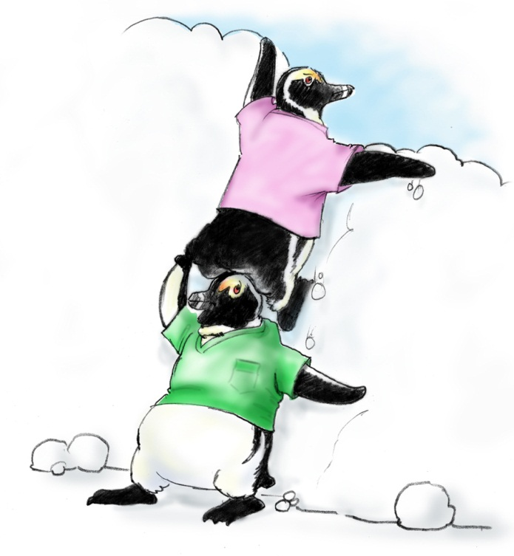
Mutual Support

Slide 2
Objectives
Describe how mutual support affects team processes and outcomes
Discuss specific strategies to foster mutual support (e.g., task assistance, feedback)
Identify specific tools to facilitate mutual support
Describe conflict resolution strategies

Slide 3
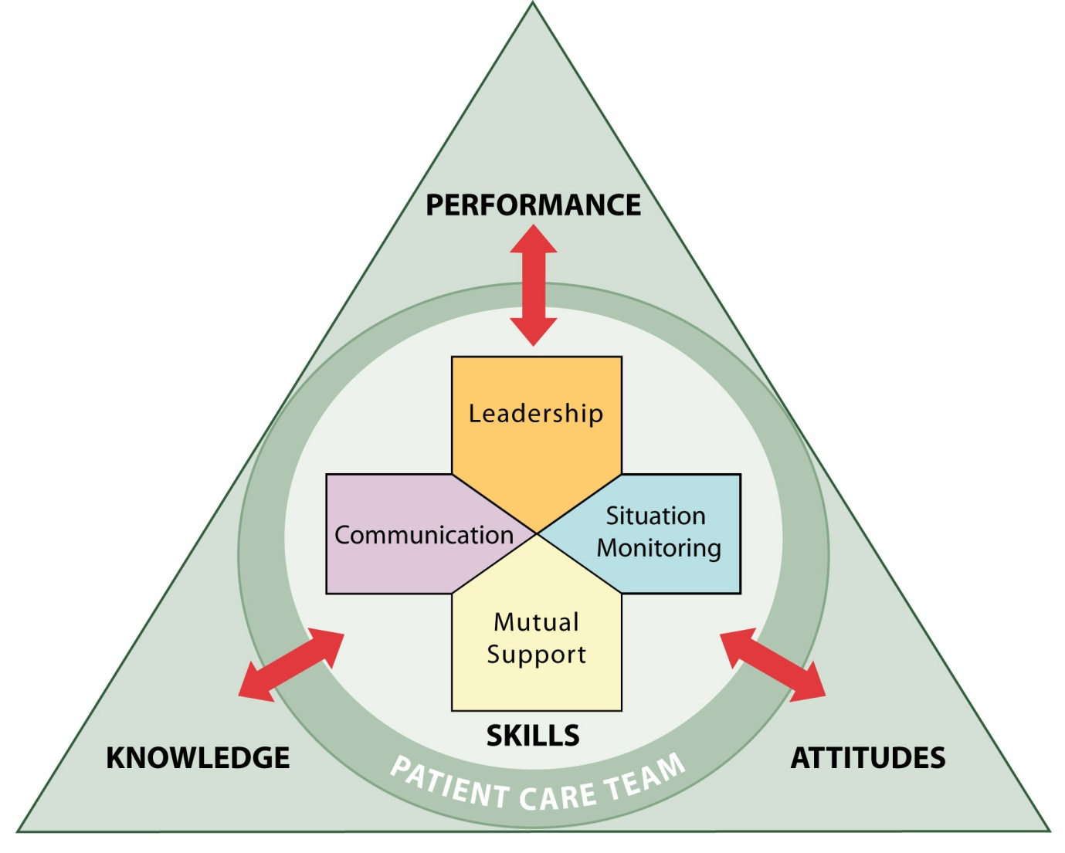
Mutual Support
Dependent upon information gathered through situation monitoring
Moderated by the communication of information
Enhanced by leaders who encourage and role model mutual support behaviors

Slide 4
Mutual Support
Mutual support involves members:
Assisting each other
Providing and receiving feedback
Exerting assertive and advocacy behaviors when patient safety is threatened

Slide 5
Task Assistance
Team members foster a climate in which it is expected that assistance will be actively sought and offered as a method for reducing the occurrence of error.

Slide 6
Task Assistance Example

Slide 7
What Is Feedback?
“Feedback is the giving, seeking, and receiving of performance-related information among the members of a team.”
(Dickinson and McIntyre 1997)

Slide 8
Feedback

Slide 9
Types of Feedback
Formal
Retrospective and typically scheduled in advance
Has an evaluative quality
Examples: Collaborative discussions, case conferences, individual performance reviews
Informal
Typically in real time
Provided on an ongoing basis
Focuses on knowledge and practical skills development
Examples: Huddles, debriefs

Slide 10
Characteristics of Effective Feedback
Effective feedback is—
Timely
Respectful
Specific
Directed toward improvement
Helps prevent the same problem from occurring in the future
Considerate

Slide 11
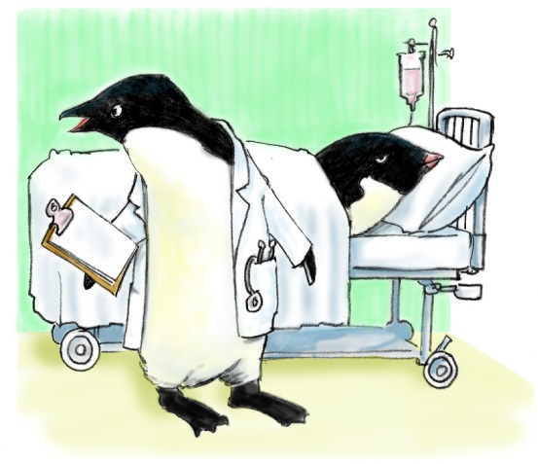
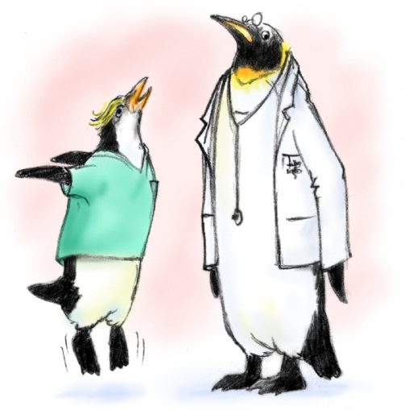
Advocacy and Assertion
Advocate for the patient
Invoked when team members’ viewpoints don’t coincide with that of a decision maker
Assert a corrective action in a firm and respectful manner

Slide 12
Two-Challenge Rule
Invoked when an initial assertion is ignored…
It is your responsibility to assertively voice your concern at least two times to ensure that it has been heard
The member being challenged must acknowledge
If the outcome is still not acceptable
Take a stronger course of action
Use supervisor or chain of command

Slide 13
Two-Challenge Rule
1
2

Slide 14
Two-Challenge Rule cont.
Empower any team member to “stop the line” if he or she senses or discovers a breach of safety.
This is an action never to be taken lightly, but it requires immediate cessation of the process and resolution of the safety issue.

Slide 15
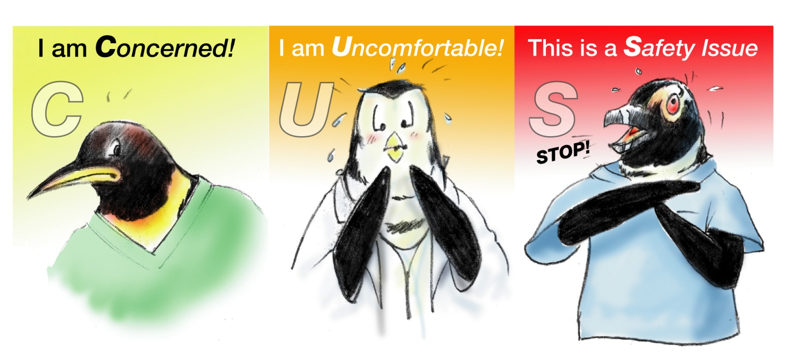
Please Use CUS Words but only when appropriate!

Slide 16
CUS

Slide 17
Conflict Resolution DESC Script
A constructive approach for managing and resolving conflict
D—Describe the specific situation
E—Express your concerns about the action
S—Suggest other alternatives
C—Consequences should be stated

Slide 18
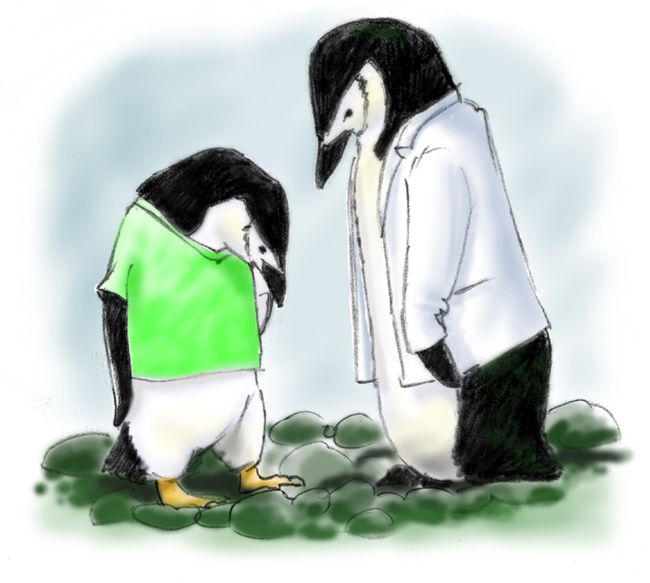
DESC-It
Let’s “DESC-It!”
Have timely discussion
Work on win-win
Frame problem in terms of your own experience
Choose a private location
Use “I” statements; avoid blaming statements
Critique is not criticism
Focus on what is right, not who is right

Slide 19
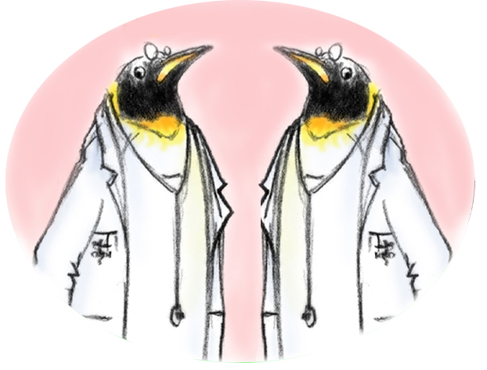
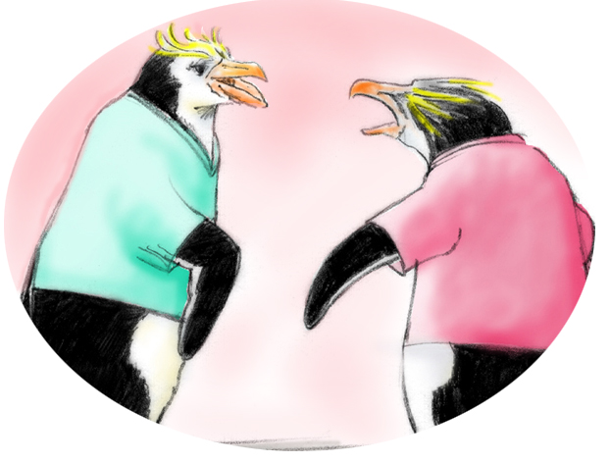
Conflict in Teams
Interpersonal Conflict
(Hostile and harassing behavior)
DESC Script
Informational Conflict
(We have different information!)
Two-Challenge Rule

Slide 20
Tools & Strategies Summary
BARRIERS
Inconsistency in Team Membership
Lack of Time
Lack of Information Sharing
Hierarchy
Defensiveness
Conventional Thinking
Complacency
Varying Communication Styles
Conflict
Lack of Coordination and Followup With Coworkers
Distractions
Fatigue
Workload
Misinterpretation of Cues
Lack of Role Clarity
TOOLS and STRATEGIES
Communication
SBAR
Call-Out
Check-Back
Handoff
Leading Teams
Brief
Huddle
Debrief
Situation Monitoring
STEP
I’M SAFE
Mutual Support
Task Assistance
Feedback
Assertive Statement
Two-Challenge Rule
CUS
DESC Script
OUTCOMES
Shared Mental Model
Adaptability
Team Orientation
Mutual Trust
Team Performance
Patient Safety!!

