Slide 1
Implementation Planning

Slide 2
Objectives
Describe the steps involved in implementing TeamSTEPPS
Develop a TeamSTEPPS Implementation Plan

Slide 3
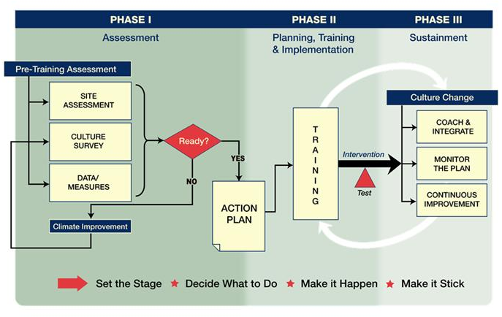
Shift Toward a Culture of Safety

Slide 4
TeamSTEPPS Action Planning At-A-Glance
1
Create a Change Team
2
Define the Problem/Challenge or Opportunity for Improvement
3
Define the Aim(s) of your TeamSTEPPS Intervention
Identify Priority Problem/
Challenge or Opportunity from Step 2
4
Define the TeamSTEPPS Intervention
Develop Plan for Testing the Effectiveness of Your TeamSTEPPS Intervention
5
6
Develop Implementation Plan
7
Develop a Plan for Sustained Continuous Improvement
8
Develop a Communication Plan
Incorporate Feedback from Key Personnel
9
Putting it All Together: Writing the TeamSTEPPS Action Plan
Review your TeamSTEPPS Action Plan with Key Personnel
10

Slide 5
Key Principles of Implementation
The Implementation Guide is based on the principle of improving patient safety and quality of care by improving health care team processes. Key activities include:
Identifying a recurring problem or opportunity for improvement
Developing a flowchart or map of the process
Studying the process to identify risk points
Implementing interventions aimed at eliminating the risk points
Testing the intervention
Sustaining positive changes

Slide 6
Implementation: Where to Start?
Congratulations, you’re a TeamSTEPPS Master Trainer.
Now what?

Slide 7
Implementation: Where to Start?
You’ve learned dozens of tools to help implement TeamSTEPPS in your unit or institution.
Do NOT plan to roll them all out at once.
You may not even roll TeamSTEPPS out in all units at once.

Slide 8
Implementation: Where to Start?
Focus: on a single or small number of tools.
Focus: on a single unit
Focus your rollout.

Slide 9
Implementation Example
Three samples from Tulane Hospital & Clinics rollout.
Handoff form
Post Fall Debriefing Tool
Surgical Safety Checklist

Slide 10
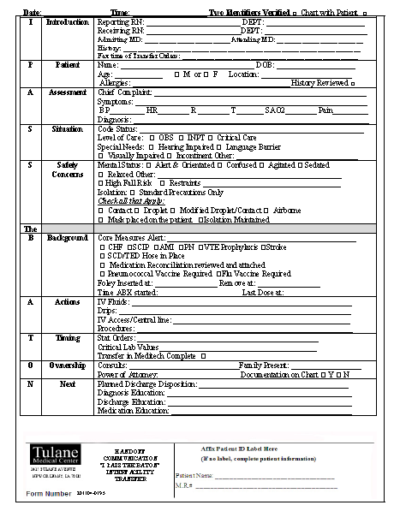

Slide 11
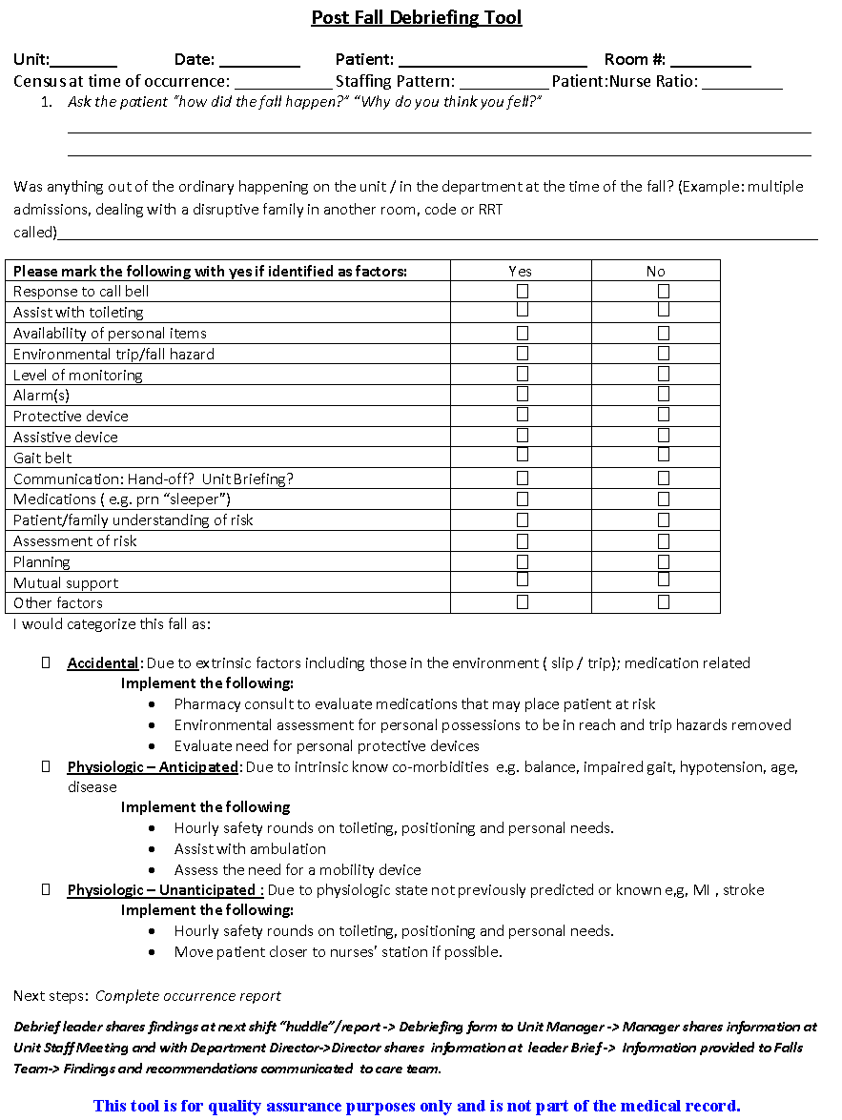

Slide 13
Implementation Example
Education examples from Tulane SOM
UME – interprofessional sessions
GME – TeamSTEPPS Essentials in Orientation
For all – simulation scenarios debriefed for TS

Slide 14
Professional Students: Examples from Tulane
Interprofessional sessions among medical students, nursing, pharmacy
Brief didactic on specific tools
Simulation case (code call) debriefed for teamwork, leadership, and communication

Slide 15
Residents & Fellows
All interns and new Fellows are scheduled for TeamSTEPPS Essentials sessions during their Orientation week.
Ensures they have exposure to the tools and concepts before beginning at Tulane Hospital.

Slide 16
Examples of Simulation for TeamSTEPPS
Works for all levels
Run simulation cases that allow demonstration of TeamSTEPPS concepts: teamwork, leadership, mutual support, situation monitoring, or communication.
Debrief on these concepts, not on medical knowledge or skills.

Slide 17
TeamSTEPPS Scenarios
Rapid Response Code Call – demonstrates all concepts
CVC Placement with confederate MD contaminating the field – demonstrates situation monitoring and communication

Slide 18
Suggested Plan Focus: Handoffs
Illness: How sick
Patient Summary: Diagnosis and plans
Actions: To do list
Situation: Contingency plans
Synthesis: Receiver summarizes and asks questions

Slide 19
TeamSTEPPS Implementation Planning Workshop
Break into working groups by best alignment of common issues
Start to develop your Action Plan
Be ready to present and discuss your Action Plan with the larger group after lunch

