Slide 1
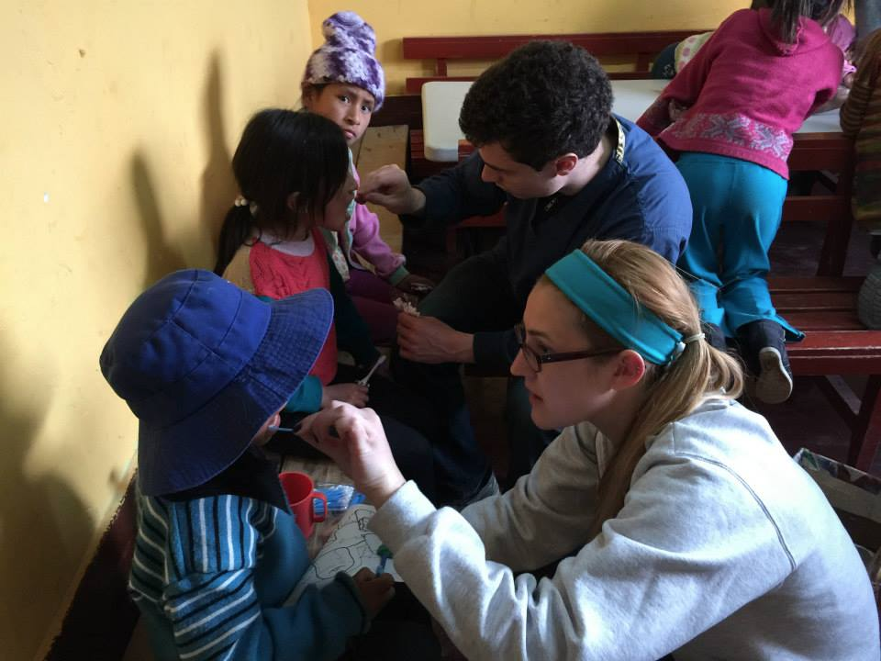
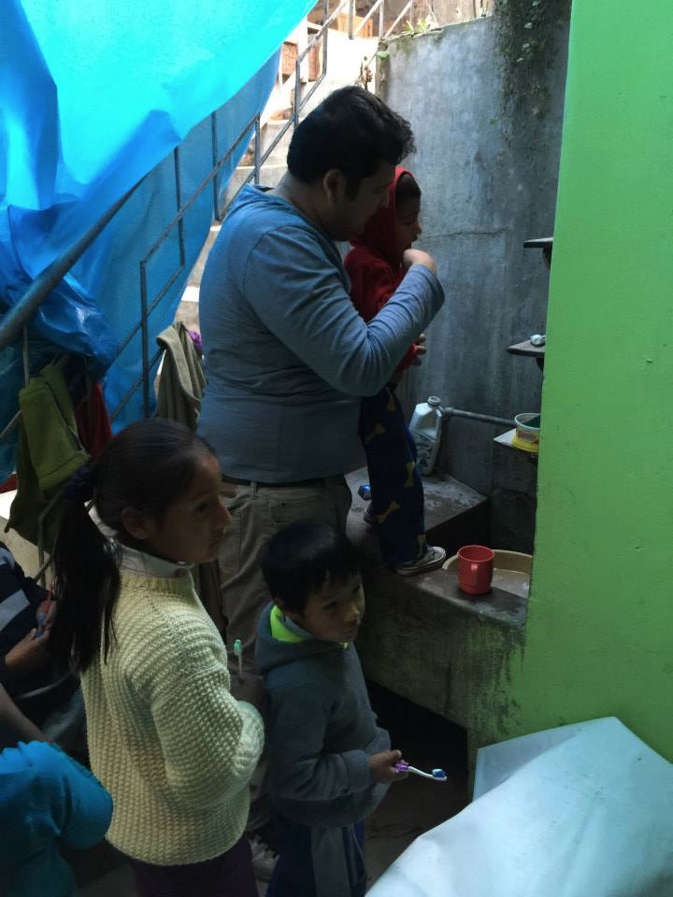
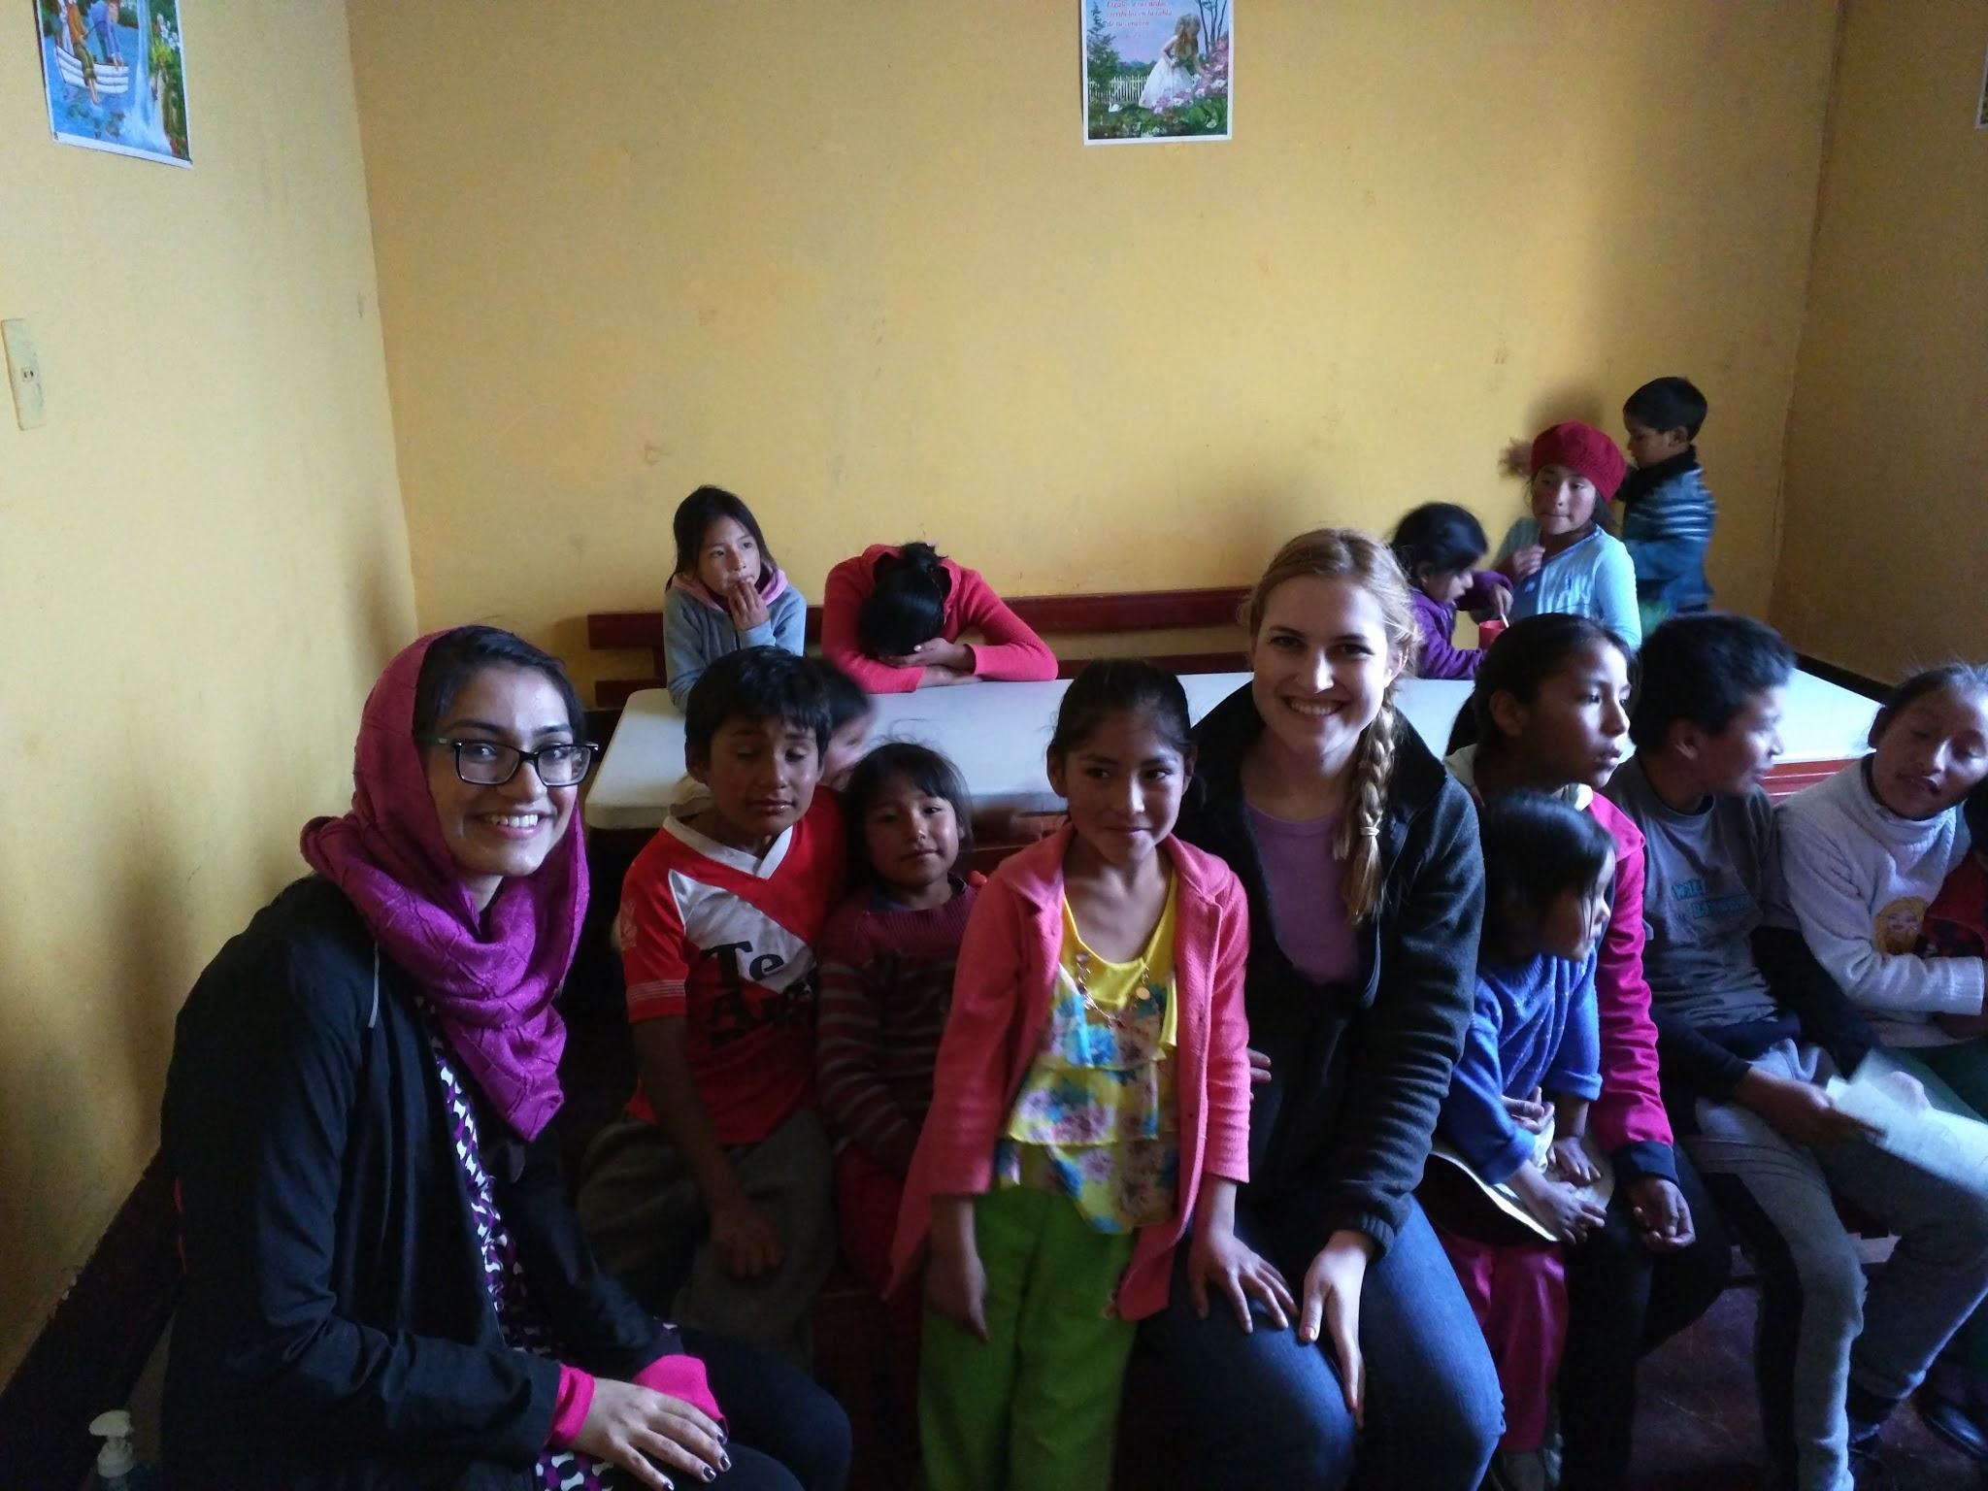
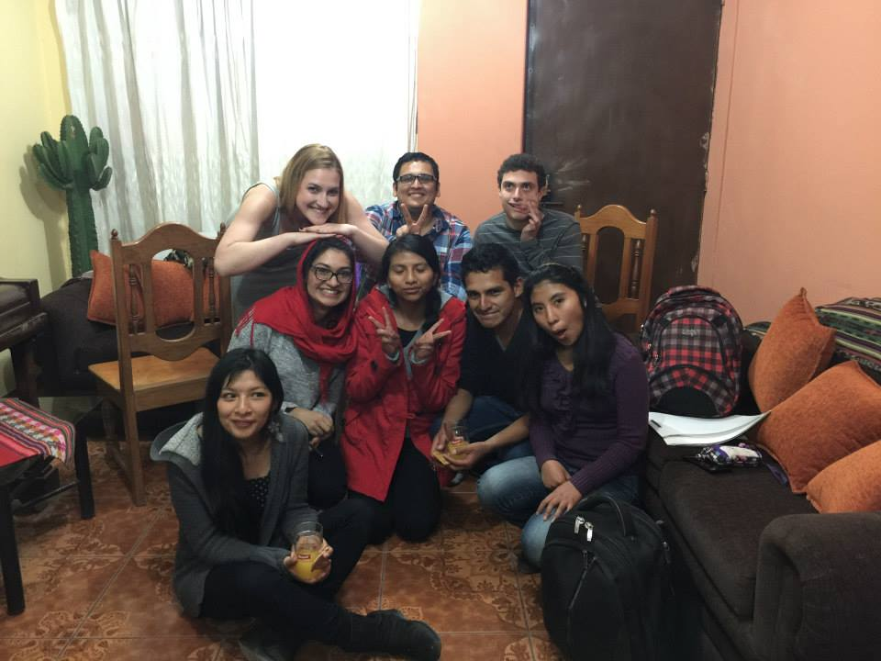
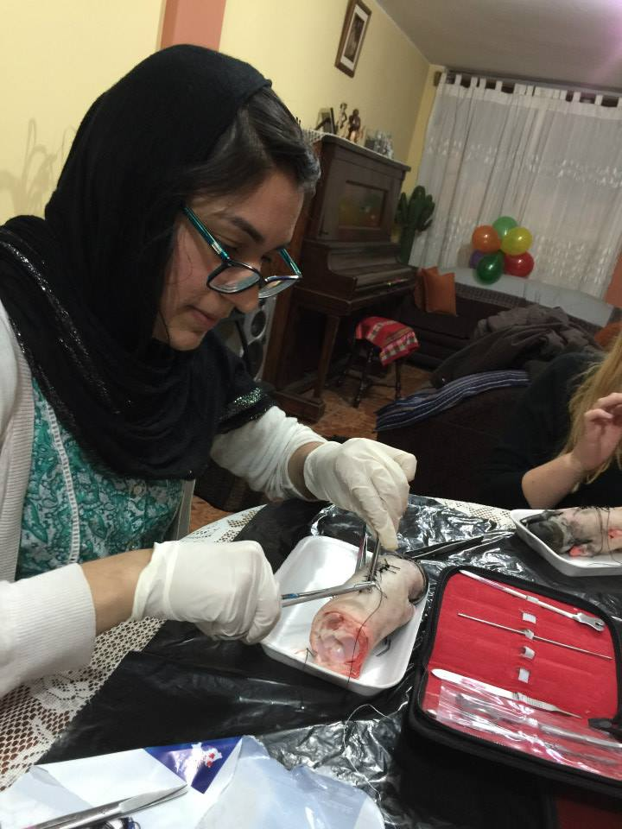
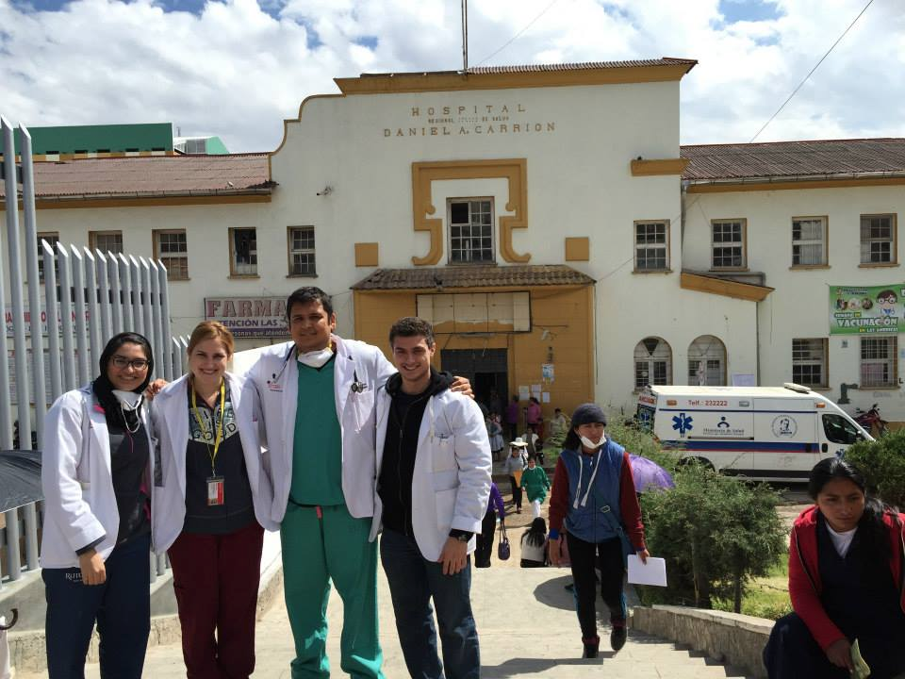
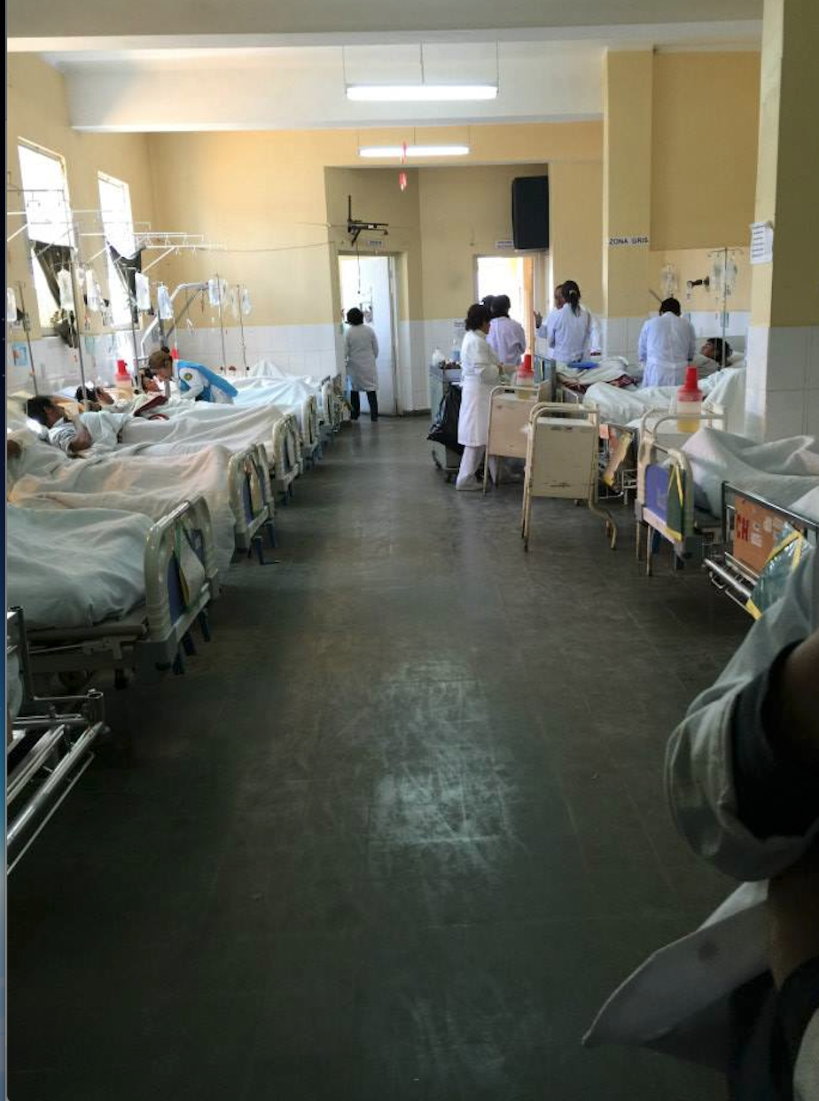
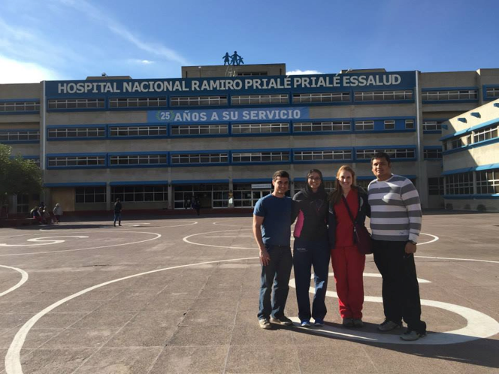
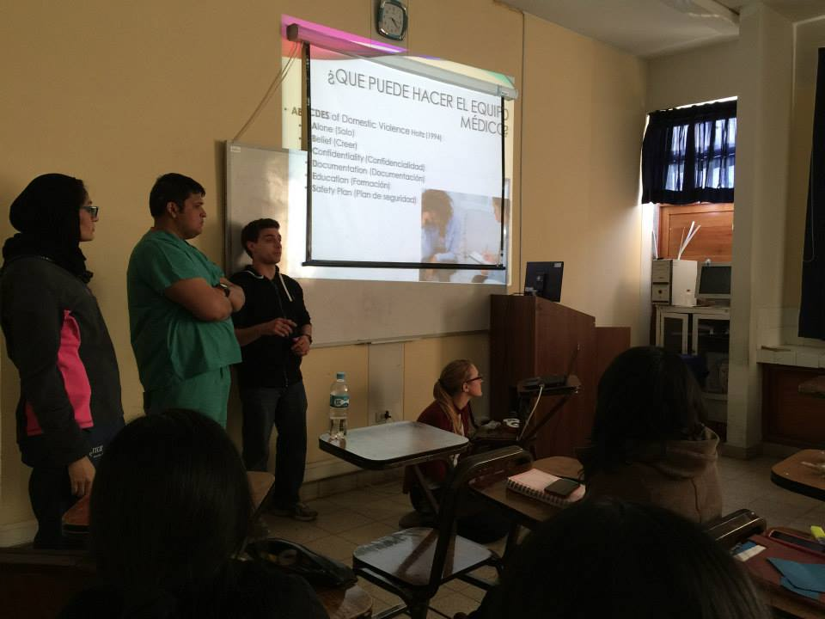
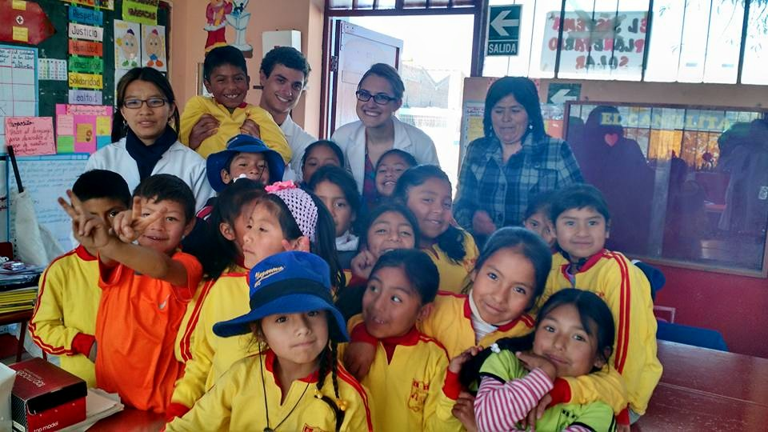
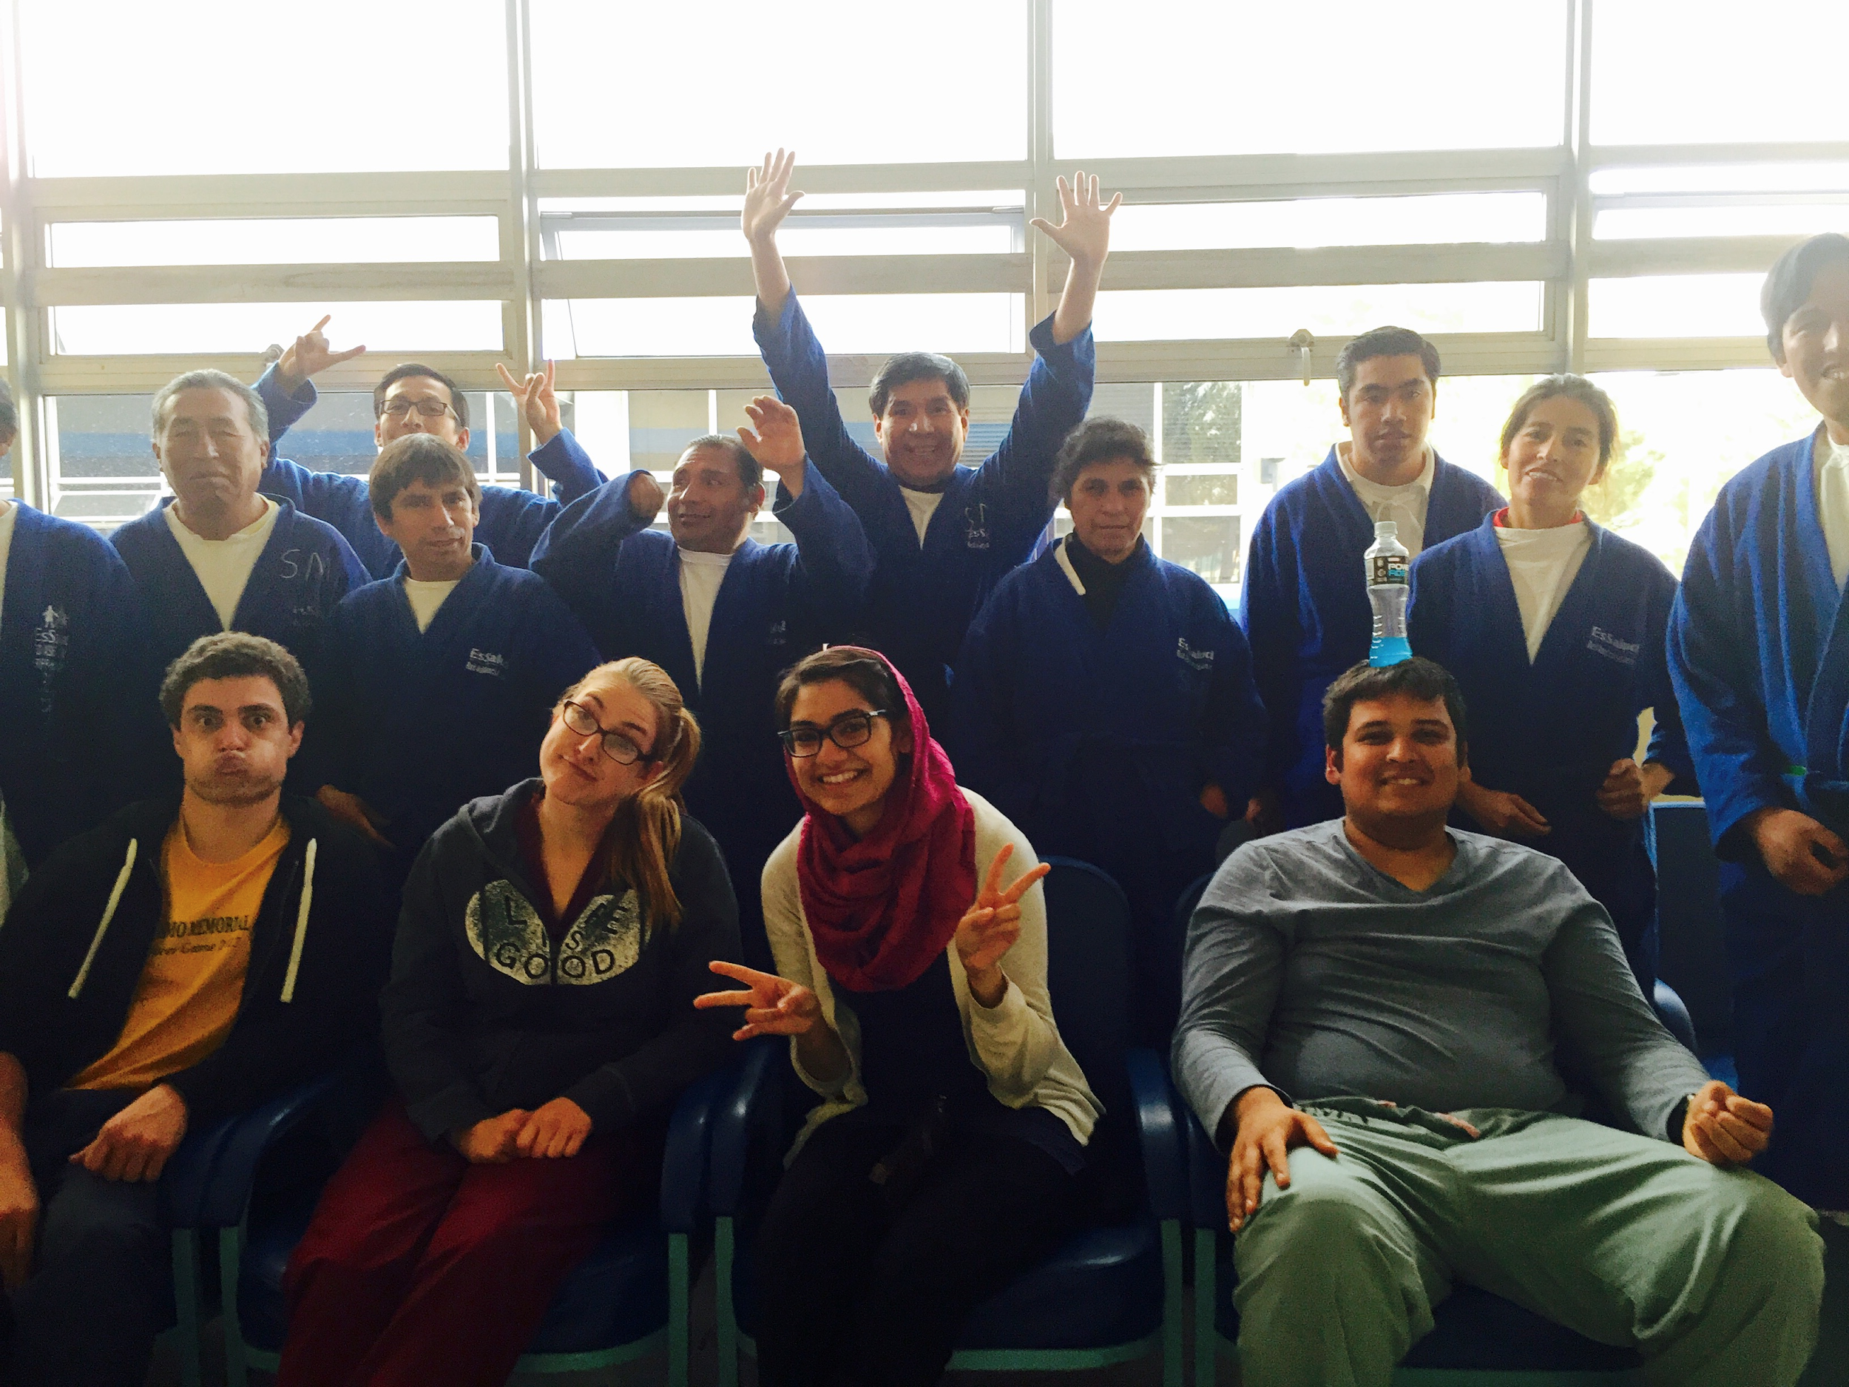
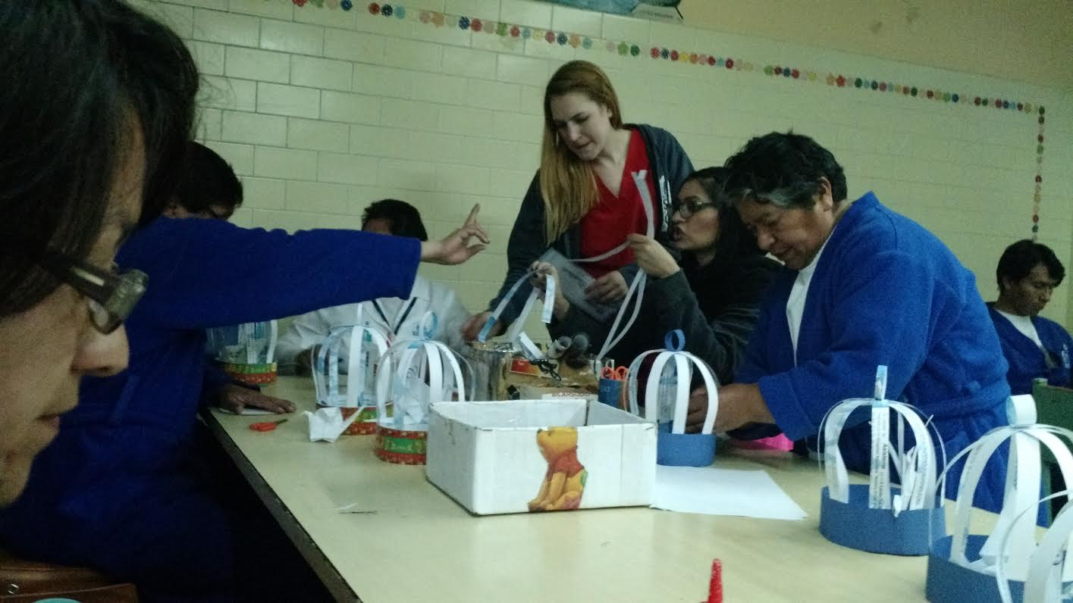
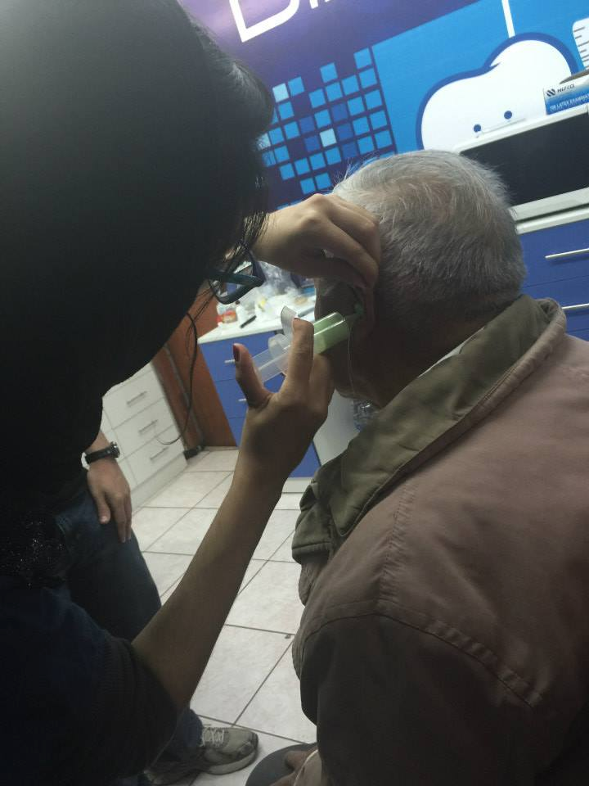
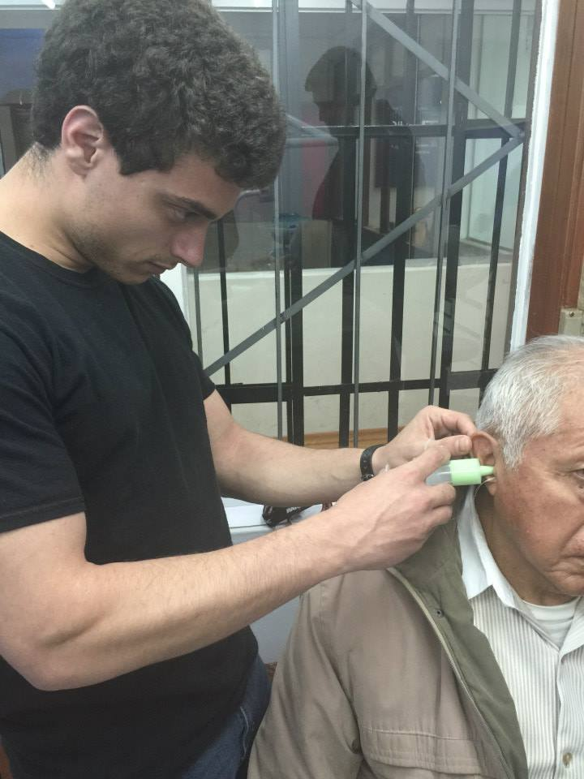
Beyond Healthcare in Huancayo, Peru
Atmatzidis DA¹, Earley CE¹, Mansoor A¹, Shah HA¹, Lindenthal JJ, PhD., Dr. PH.¹
¹ Mini-Med International, Rutgers the State University of New Jersey, New Jersey Medical School, Newark, NJ 07103
New Jersey Medical School
Mini-Med International
Sicaya
Collaborating with Local Medical Students
For the month of June 2015, four second year medical students traveled to Huancayo in the Mantaro Valley of Peru in order to provide medical care to those less fortunate in terms of resources and access, to educate local students in both healthcare-related and general education topics, and to volunteer at community centers such as a local orphanage.
Mini-Med International is a branch of the Mini-Med Program of RBHS-New Jersey Medical School. Mini-Med International seeks to provide global outreach to areas with limited resources and healthcare. The program has successfully sponsored eight trips to Peru and are in the process of planning more for the following summer.
Two of the nights we stayed in Huancayo, we had the opportunity to learn from local medical students. First, they showed us how they triage and collect medical histories from patients. The hospitals in Huancayo use paper records, and along with the words being in Spanish, the experience was definitely unique. On the second visit, a local nurse and a medical student brought pigs’ feet to our hostess’ house and allowed us to practice suturing on the dining room table. Their instruction was very detailed and it was the first experience many of us had with a needle and thread.
Every Friday afternoon our group took a local bus to the small town of Sicaya, where we did activities with children at a church. The children were between 3 and 10 years old. We taught them how to properly wash their hands, brush their teeth, and we applied fluoride. We taught them English words and practiced English with games. Also, we played games with the children, taught them English songs, and learned from them as they learned from us.
Carrion and EsSalud Hospitals
Domestic Violence Lecture
A public university invited us to lecture about domestic violence to nursing students. Using the information we learned from school and researching the various resources available to people in Peru and in Huancayo in particular, we managed to develop a lively discourse with the students over gender roles, how the authorities in Peru react to cases of domestic violence, and when as healthcare professionals we should intervene.
Every morning we would attend rounds and observe patients with various ailments, such as stroke, cirrhosis, cholecystitis, and pulmonary disease. We had learned about these conditions in the classroom and now we were able to observe patients suffering from them in Peru. We performed rounds at Carrion Hospital, which is the hospital utilized by patients with no or minimal insurance. On the other hand, the patients who had insurance received treatment at EsSalud. One of the many differences which could be observed between the hospitals was that the patients at Carrion had minimal privacy, often sharing a room with multiple people, while many patients at EsSalud had their own rooms. In addition, there were limited procedures offered at Carrion Hospital and the waiting period to receive procedures/results was longer.
Reflections and Outlook
“As I am traveling from Lima to Huancayo, I am truly amazed by the natural beauty that exists in this country. At the same time I see the sheds that people live in, at times without electricity, and I am reminded that not everybody has the luxuries that I sometimes take for granted. My experience in Peru was very enriching and eye-opening and it confirmed my passion for global health.”
- Amtul Mansoor
“I learned how to better compromise and communicate when thrown into a new situation, living with strangers and people who I only previously knew from occasional quick conversations in the elevator or leaving the lecture hall. I also learned how lucky we are in the United States with the resources we have and the care we can provide.”
- Chelsea Earley
“My experiences will make me into a better doctor who can communicate well with his patients, as well as help me become a better person who can appreciate all the advantages I have had in life.”
- Harsh Shah
“I will without a doubt recommend this trip to future NJMS classes!”
- Doug Atmatzidis
The Mini-Med International Trip to Peru will return in Summer 2016.
Dental Hygiene at Local School
Our group assisted a dentist at a local underprivileged school to educate the students about dental hygiene. We helped reveal the bacteria in their mouths, taught them how to properly brush their teeth with the toothbrushes and toothpaste we distributed, and how to use mouthwash. We also applied fluoride to their teeth.
Connecting with Psychiatric Patients
A few afternoons during our stay in Huancayo, we visited the psychiatric patients at EsSalud. In particular, we organized arts and crafts sessions with the patients and provided resources to aid our patients in their recovery, such as self-help books. The patients suffered from depression, alcoholism, schizophrenia, and developmental disorders; they came from a variety of backgrounds, including successful engineers, military surgeons, and teachers.
Aiding the Audiologist
One afternoon, a local audiologist welcomed us to a charity event where we helped her interview patients and injected a molding foam into their ears so that they could be fitted for hearing aides. It was a great opportunity to interact with patients as well as gain some hands-on experience.
Acknowledgements
Thank you to Dr. Lindenthal (lindenth@njms.rutgers.edu), NJMS Alumni Association, and Chusi Wanka. Chusi Wanka is our local partner organization.

