Slide 1
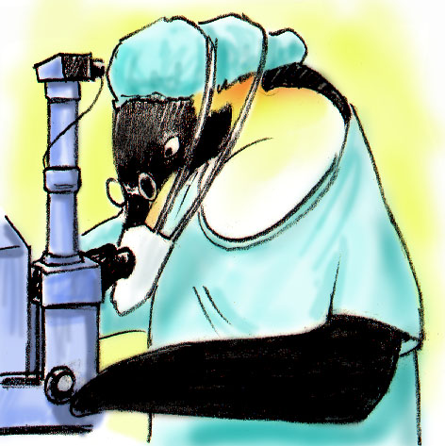
Team Structure
NEXT:

Slide 2
Objectives
Discuss benefits of teamwork and team structure
Define a “team”
Identify the role of patients and their families as part of the care team
Describe the components and composition of a multi-team system

Slide 3
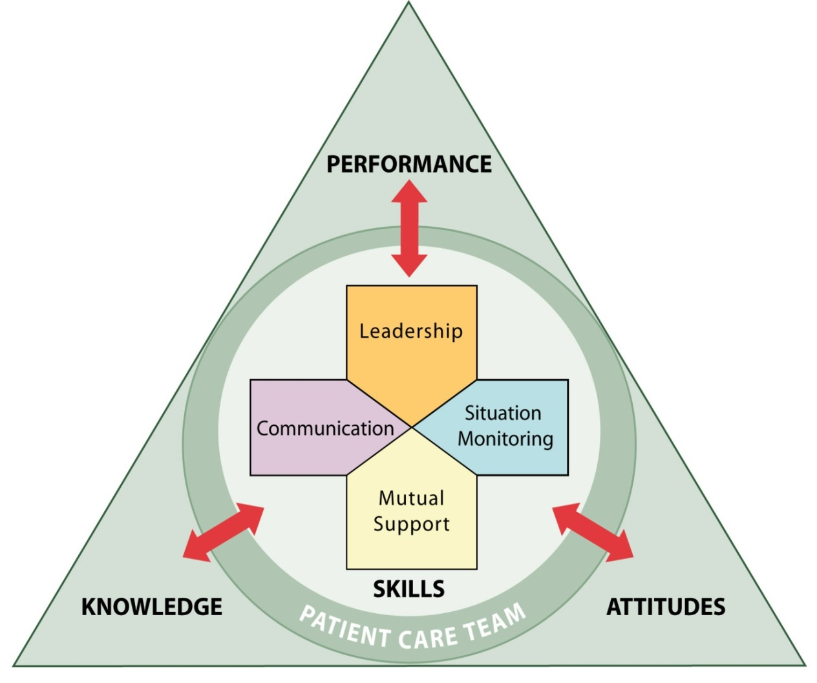
Team Structure
Teamwork cannot occur in the absence of a clearly defined team
Understanding a team’s structure and how multiple teams interact is critical for implementation planning

Slide 4
Partnering With the Patient
Strategies for involving patients in their care
Include patients in bedside rounds
Conduct handoffs at the patient’s bedside
Provide patients with tools for communicating with their care team
Involve patients in key committees
Actively enlist patient participation

Slide 5
What Defines a Team?
Two or more people who interact dynamically, interdependently, and adaptively toward a common and valued goal, have specific roles or functions, and have a time-limited membership

Slide 6
Clinical Team Responsibilities
Embrace patients and their families as valuable and contributing partners in patient care
Listen to patients and their families
Assess patients’ preference regarding involvement
Ask patients about their concerns
Speak to them in lay terms
Allow time for patients and families to ask questions
Ask for their feedback
Give them access to relevant information
Encourage patients and their families to proactively participate in patient care

Slide 7
Patient and Family Responsibilities
Provide accurate patient information
Comply with the prescribed plan of care (e.g., schedule and attend appointments as directed)
Ask questions and/or voice any concerns regarding the plan of care
Monitor and report changes in the patient’s condition
Manage family members
Follow instructions of the clinical team

Slide 8
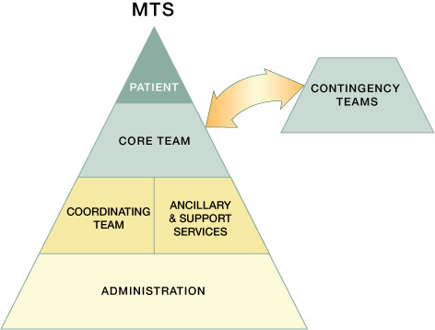
Multi-Team System (MTS) for Patient Care

Slide 9
Types of Teams
Core Team – closest to the patient. Work to manage a set of assigned patients from assessment to disposition
Contingency Team - time-limited team formed for emergent or specific events, members of various teams
Coordinating Team - work area members responsible for managing the operational environment
Ancillary & Support Services - provide direct, task-specific, time-limited care to patients. Provide indirect service-focused
Administration – vision, policies, expectations, accountability, culture change

Slide 10
How’s the Teamwork?
Video: ER, No Help

Slide 11
How’s the Teamwork?
Video: Bathroom

Slide 12
High Performing Teams
Teams that perform well:
Hold shared mental models
Have clear roles and responsibilities
Have clear, valued, and shared vision
Optimize resources
Have strong team leadership
Engage in a regular discipline of feedback
Develop a strong sense of collective trust and confidence
Create mechanisms to cooperate and coordinate
Manage and optimize performance outcomes
(Salas, et al., 2004)

Slide 13
Barriers to Team Performance
Inconsistency in team membership
Lack of time
Lack of information sharing
Hierarchy
Defensiveness
Conventional thinking
Varying communication styles
Conflict
Lack of coordination and follow-up
Distractions
Fatigue
Workload
Misinterpretation of cues
Lack of role clarity

Slide 14
Up Next, TeamSTEPPS
Communication.
What is good communication?
Will everyone understand the same message?

