Slide 1
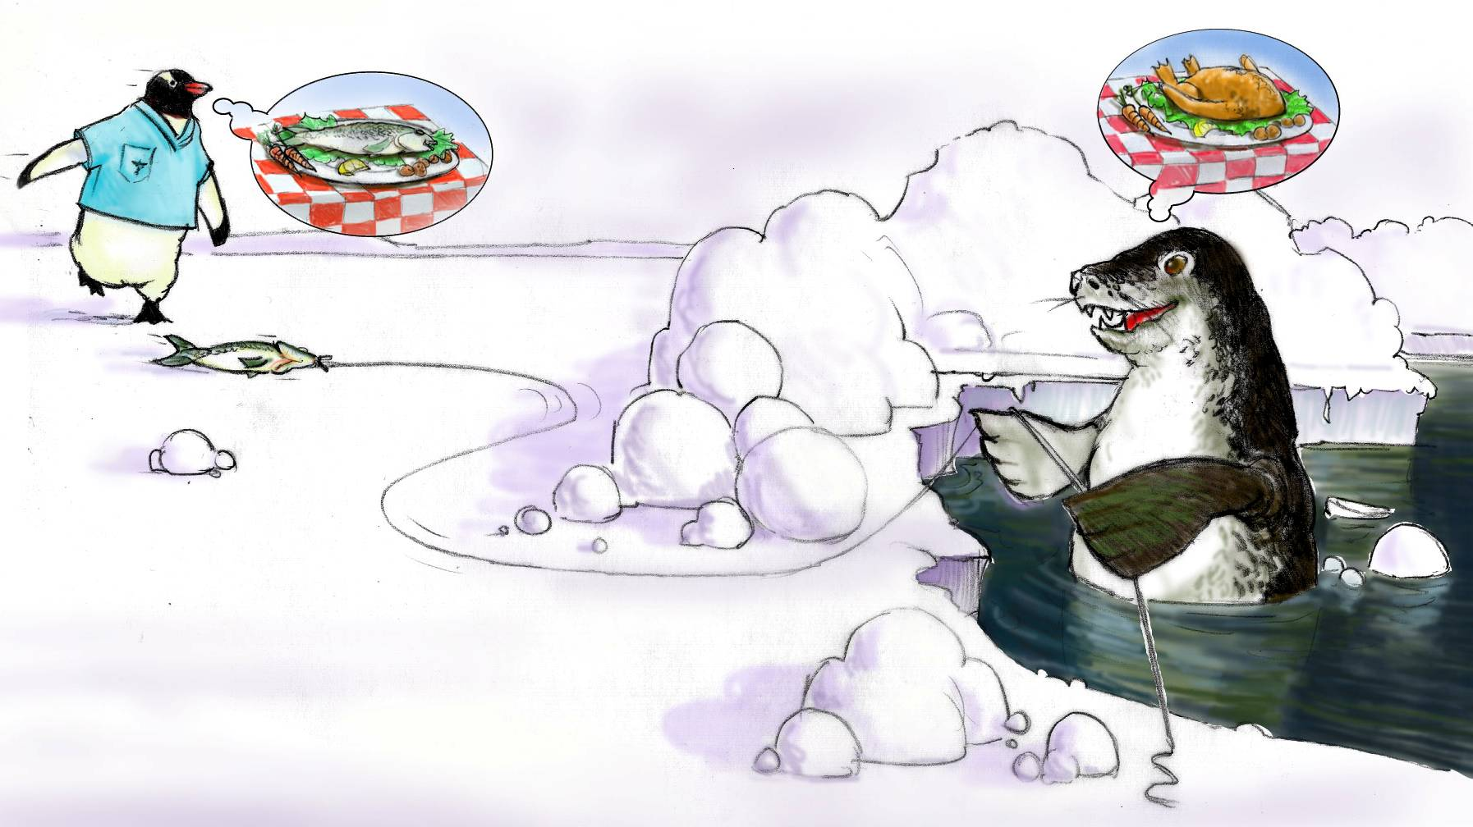
Situation Monitoring

Slide 2
Objectives
Discuss how situation monitoring affects team processes and outcomes
List components of the STEP mnemonic
Explain situation awareness and identify undermining conditions
Define a shared mental model and how it is cultivated within a team

Slide 3
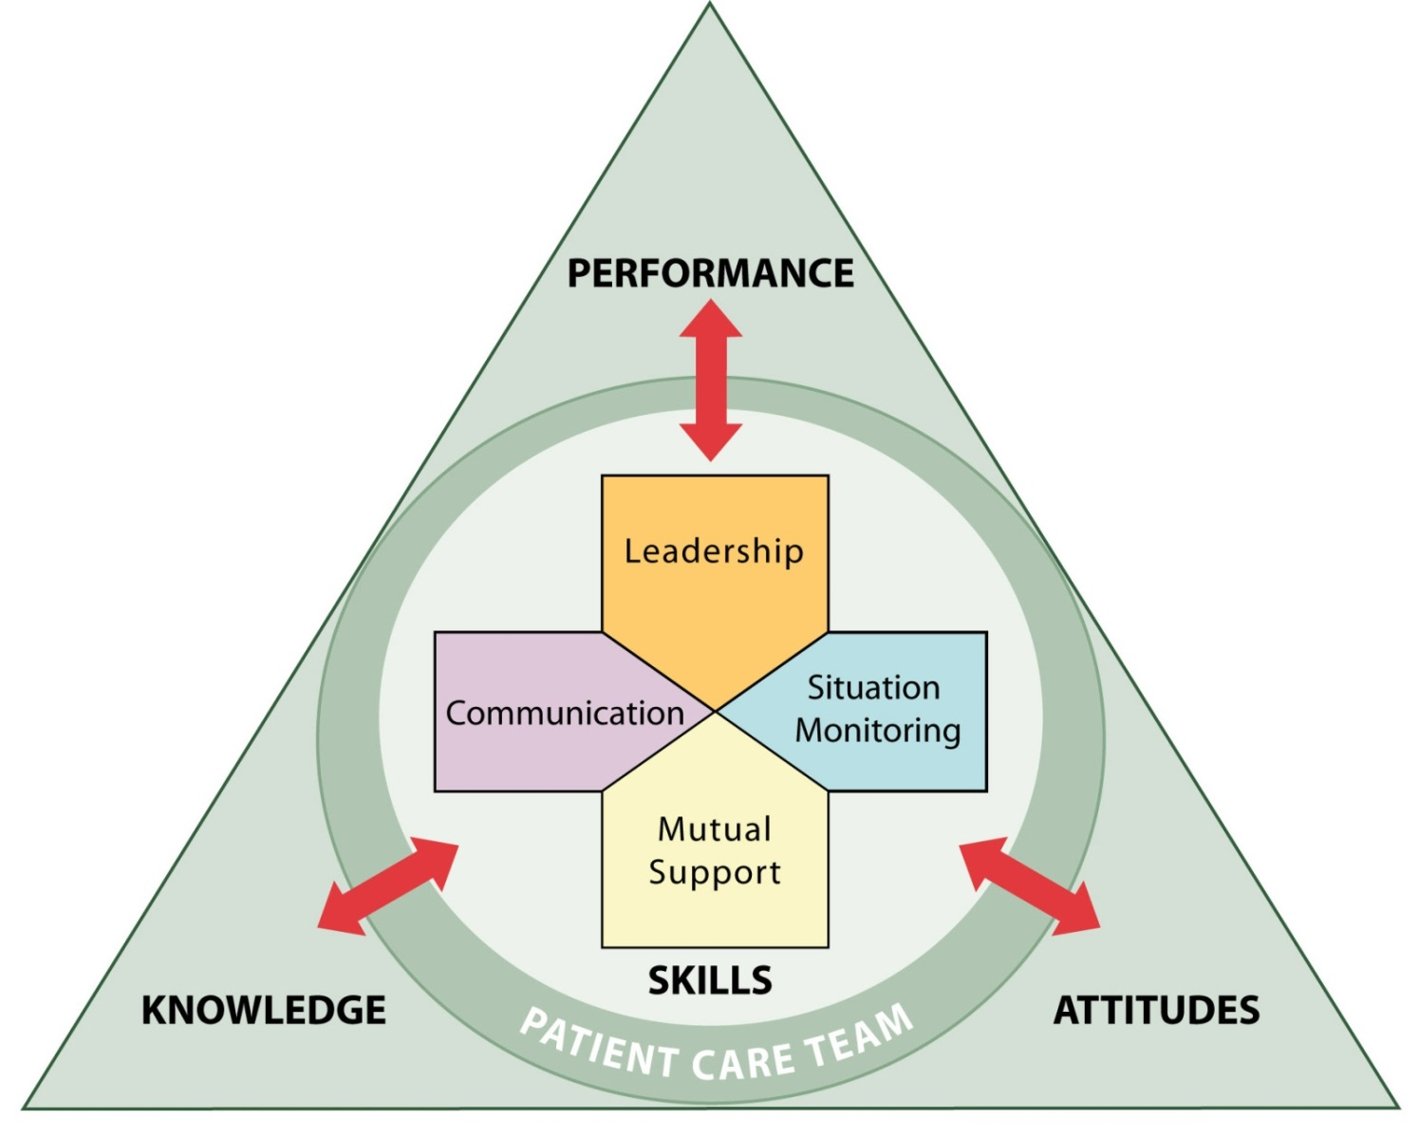
Situation Monitoring
Ensures new or changing information is identified for communication and decision-making
Leads to effective support of fellow team members

Slide 4
Awareness Test
Video: Awareness

Slide 5
Video: Awareness

Slide 6
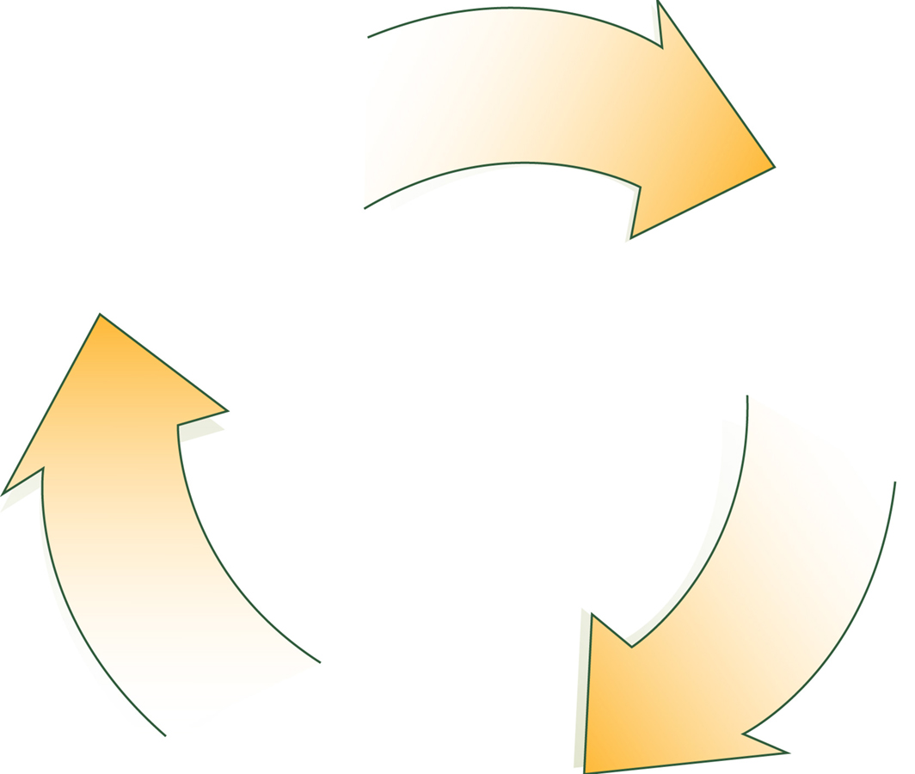
A Continuous Process
Situation Monitoring (Individual Skill)
Situation Awareness (Individual Outcome)
Shared Mental Model (Team Outcome)

Slide 7
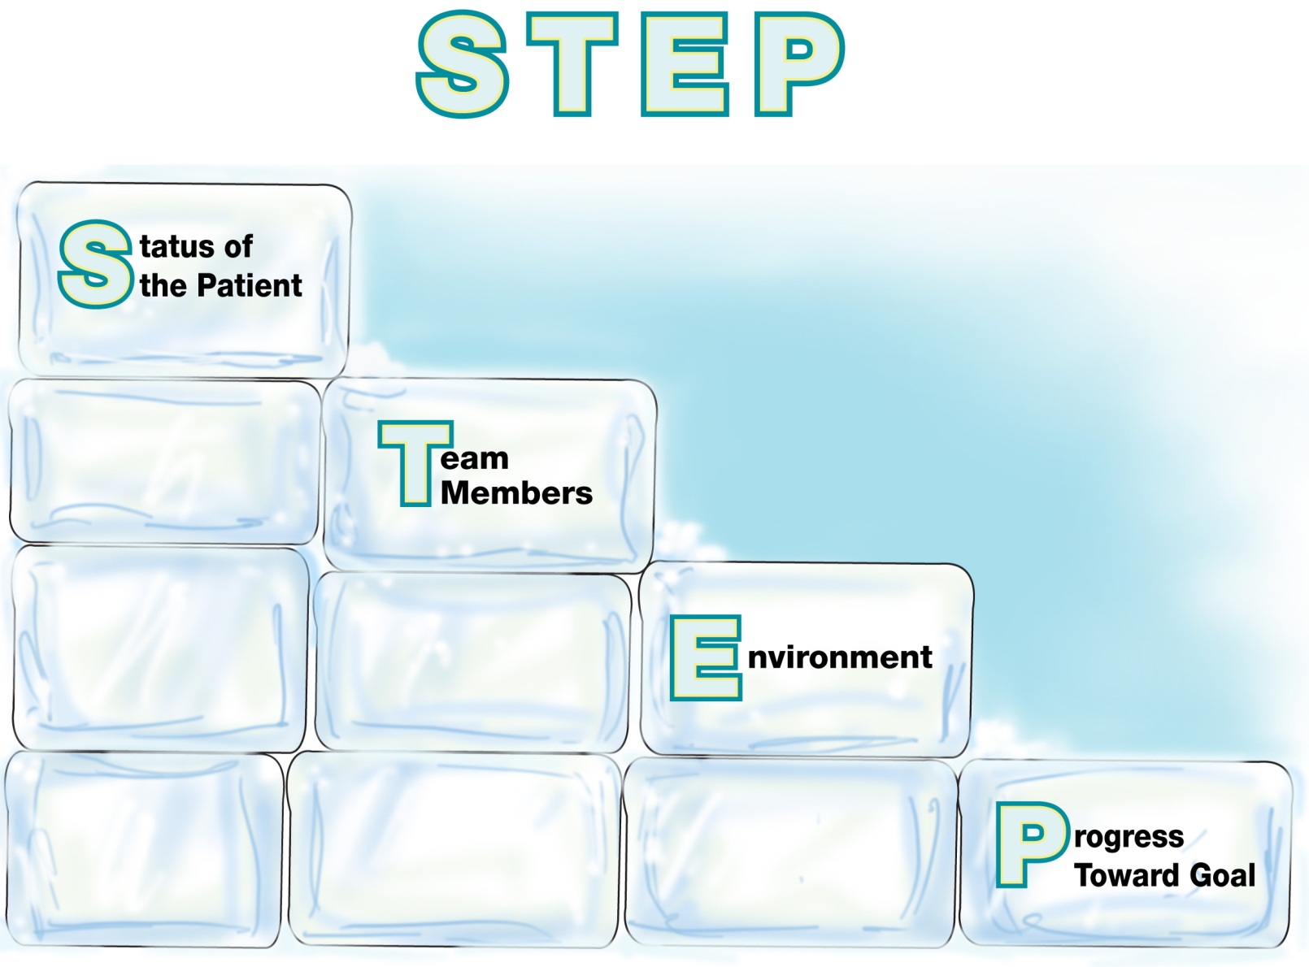
Components of Situation Monitoring

Slide 8
Status of the Patient
EXAMPLES:
Patient History
Vital Signs
Medications
Physical Exam
Plan of Care
Psychosocial Condition

Slide 9
Team Members
EXAMPLES:
Fatigue
Workload
Task Performance
Skill Level
Stress Level

Slide 10
I’M SAFE Checklist
I = Illness
M = Medication
S = Stress
A = Alcohol and Drugs
F = Fatigue
E = Eating and Elimination

Slide 11
Environment
EXAMPLES:
Facility Information
Administrative Information
Human Resources
Triage Acuity
Equipment

Slide 12
Progress Toward Goal
EXAMPLES:
Call a Huddle!
Status of Team’s Patient(s)
Goal of Team
Tasks/Actions That Are or Need To Be Completed
Plan Still Appropriate

Slide 13
Conditions That Undermine Situation Awareness
Failure to—
Share information with the team
Request information from others
Direct information to specific team members
Include patient or family in communication
Utilize resources fully (e.g., status board, automation)
Maintain documentation
Know and understand where to focus attention
Know and understand the plan
Inform team members the plan has changed

Slide 14
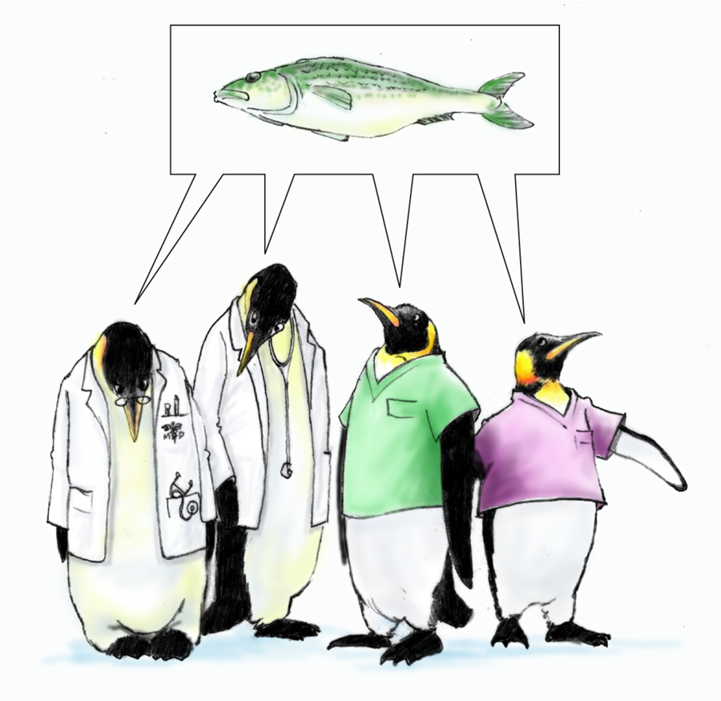
Shared Mental Model is…
The perception of, understanding of, or knowledge about a situation or process that is shared among team members through communication

Slide 15
Shared mental model
Video: Jamacian Porsche

Slide 16
When and How to Share?
When:
Briefs
Huddles
Debriefs
Transitions in Care
How:
SBAR
Call-outs
Check-backs

Slide 17
Tools & Strategies Summary
BARRIERS
Inconsistency in Team Membership
Lack of Time
Lack of Information Sharing
Hierarchy
Defensiveness
Conventional Thinking
Complacency
Varying Communication Styles
Conflict
Lack of Coordination and Followup With Coworkers
Distractions
Fatigue
Workload
Misinterpretation of Cues
Lack of Role Clarity
TOOLS and STRATEGIES
Communication
SBAR
Call-Out
Check-Back
Handoff
Leading Teams
Brief
Huddle
Debrief
Situation Monitoring
STEP
I’M SAFE
OUTCOMES
Shared Mental Model
Adaptability
Team Orientation
Mutual Trust
Team Performance
Patient Safety!!

