Slide 1
Change Management: How to Achieve a Culture of Safety

Slide 2
Objectives
List the Eight Steps of Change
Identify errors common to organizational change
Discuss what is involved in creating a new culture
Understand the definition and markers of sustainability
Present the components of a sustainability plan
Understand the role of coaching and measurement in sustainability

Slide 3
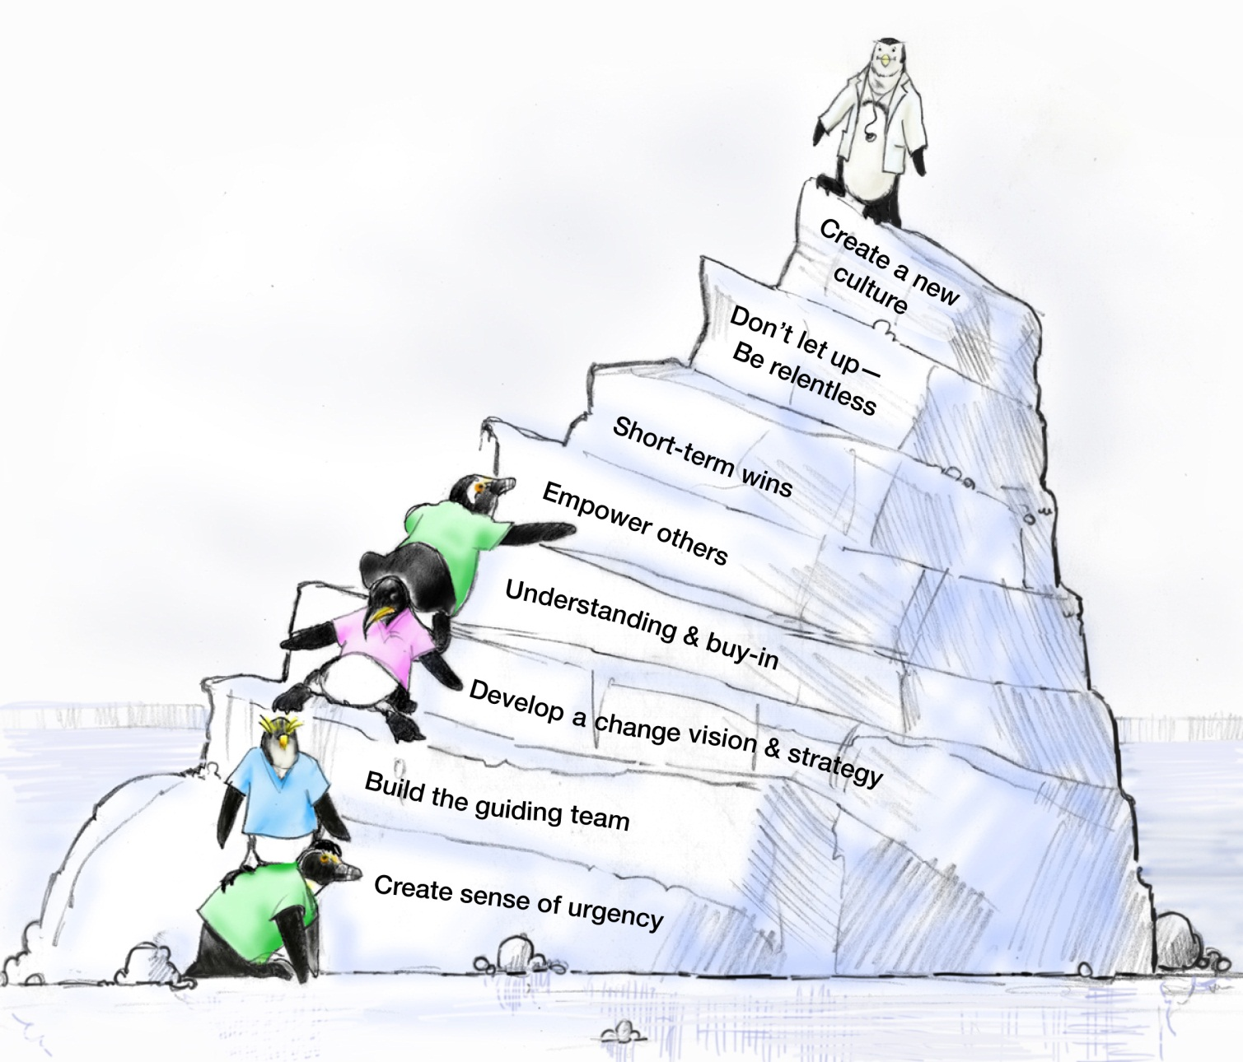
8 Steps of Change
John Kotter

Slide 4
Leadership & Change Advice

Slide 5
Set the Stage and Create a Sense of Urgency
Get people’s attention!
Sell the need for change … describe the consequences of not changing
Immerse people in information about the change
Discuss ways to solve the problems people identify with the change
Empower people to solve the “problem”

Slide 6
Pull Together the Guiding Team
Choose key players, especially staff-level managers
Identify a Guiding Team that is multidisciplinary
Consider the credibility and integrity of change leaders
Choose proven leaders who can drive the change process
Strong position power, broad expertise, and high credibility
Ensure the Guiding Team has both management and leadership skills
Management skills control the process
Leadership skills drive the change

Slide 7
Develop the Change Vision and Strategy
Senior Leadership is responsible for:
Establishing the definition of a “culture of safety” aligned with expectations, core values, and shared beliefs
Informing the organization of these values and evaluating the culture
Leading the process of:
Translating values into expected behaviors
Establishing trust and accountability
Communicating a commitment to shaping the culture

Slide 8
Communicate for Understanding and Buy-In
Provide supportive actions for fear, anger, and resistance
Encourage discussion, dissent, disagreement, debate—keep people talking
Tell people what you know―and what you don’t know
Acknowledge concerns, perceived losses, and anger
Model the expected behaviors
Value resisters
They clarify the problem and identify other problems that need to be solved first
Their tough questions can strengthen and improve the change
They may be right―it is a dumb idea!

Slide 9
Empower Others to Act
Provide direction
Allow others to find their own team-driven solutions
Encourage others to speak up and take risks
Share the information you know
Encourage teamwork and collaboration
Encourage personal reflection and learning
Train employees so they have the desired skills and attitudes
Track activities and progress
Set short-term goals

Slide 10
Produce Short-Term Wins
Show visible success; further impetus for change
Provide positive feedback; recognize and reward contributions to wins
Further builds morale and motivation
Leverage lessons learned to help plan next goal
Create greater difficulty for resisters to block further change
Provide leadership with evidence of success
Build momentum
Helps draw in neutral or reluctant supporters

Slide 11
Don’t Let Up
Acknowledge hard work
Celebrate successes and accomplishments
Reaffirm the vision
Bring people together toward the vision
Acknowledge what people have left behind
Develop long-term goals and plans
Provide tools and training to reinforce new behaviors
Reinforce and reward the new behaviors
Create systems and structures that reinforce new behaviors
Prepare people for the next change

Slide 12
Create a New Culture
Develop action steps for stabilizing, reinforcing, and sustaining the change:
Give people time to mourn their actual losses
Provide skill and knowledge training
Develop new reward systems
Recognize and celebrate accomplishments
Develop performance measures to continually monitor the results from the change and to identify opportunities for further improvements
Make adjustments to the change vision and strategy to reflect new learning and insights
Encourage people to be open to new challenges, forces, and pressures for the next change

Slide 13
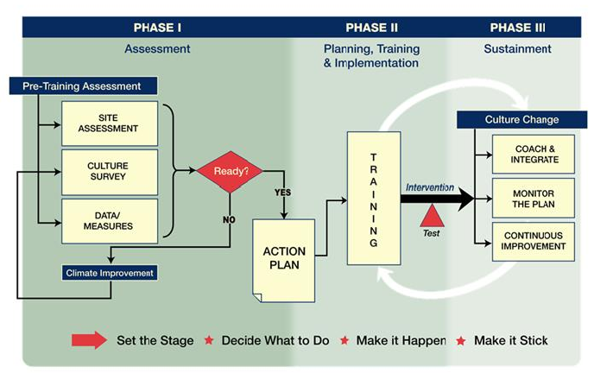
TeamSTEPPS Change Model

Slide 14
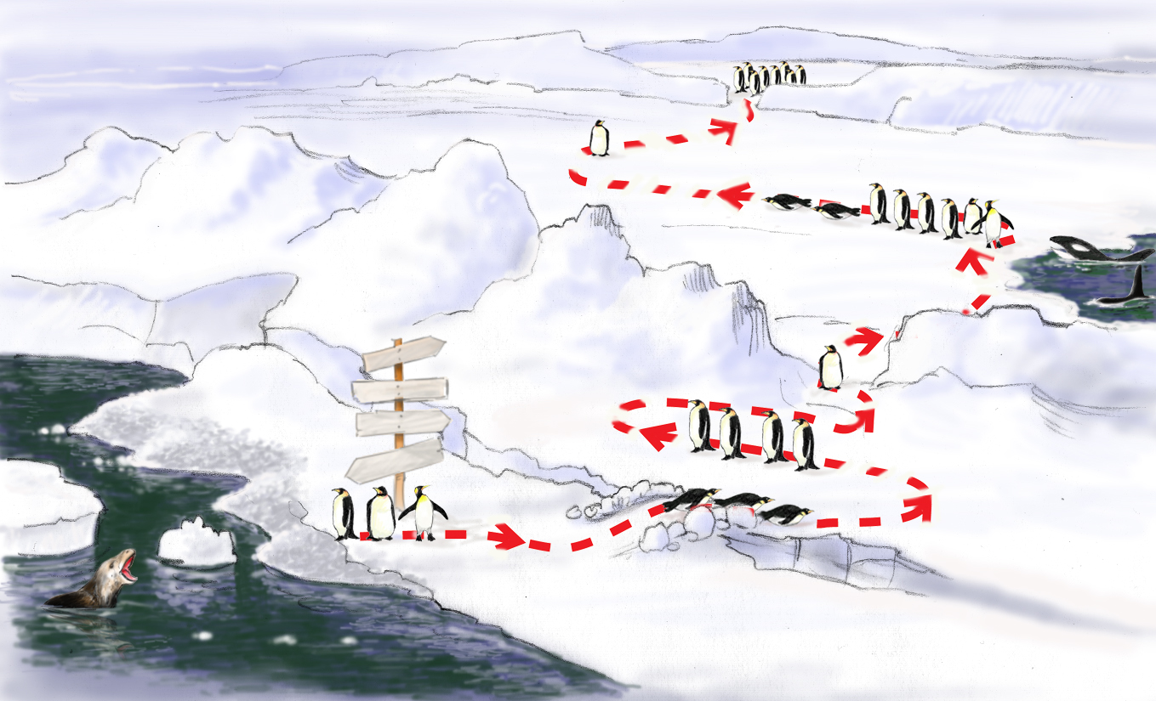
Roadmap to a Culture of Safety
Monitor, Integrate, Continuous Process Improvement
Celebrate Wins! Staying the Course Sustaining
Implement Action Plan, Train, Empower Others
Test Intervention
(Outcomes)
TeamSTEPPS Change Coaching
I’m staying right here. Yeah, they’ll be back.
What are they doing?
Joint Commission
Develop Action Plan
Status QUO
Why do we need change?
FUTURE
Errorville
Prepare the Climate
Catalytic Event Drives Need For Change
Build Team, Strategy, Buy-In, Establish Goals

Slide 15
Definition of Sustainability
Long-term continuation of project-related changes using process and outcome measures
Continued adaptation of TeamSTEPPS within a constantly shifting context
Embedding the TeamSTEPPS practices within an organization

Slide 16
Threats to Sustainability
Change is seen as a discrete project with an end date
Staff turnover
Shifting strategic priorities
Lack of change at interpersonal level
Lack of shared mental model
Insufficient staff training

Slide 17
IHI: Keys to Sustainability
Supportive Management structure
Structures to “foolproof” change
Robust, transparent feedback systems
Shared sense of systems to be improved
Culture of improvement, deeply engaged staff
Formal capacity building programs

Slide 18
Role of Coaching in Sustaining Improvement
Two way communication is essential for tailoring TeamSTEPPS interventions to new contexts
Coaching is essential for translating knowledge into lasting behavior change

Slide 19
Definition of Spread
“Spreading takes the process from the narrow, segmented population(s) or group(s) and broadens it to include all the population(s) or group(s) that will use the process.”
“Formalizing a process provides a reference to others; those new to the organization and those in the organization needing clarity about the specifics of the process.”

Slide 20
Why Spread?
Health care culture is local
Quality interventions target a process in small pilot projects usually on a local level (Lean Six Sigma, Plan-Do-Study-Act [PDSA])
Safety interventions targeted at the unit level (CUSP)
Shifting the paradigm—from hierarchical to team culture

Slide 21
Factors Affecting Spread
Leadership
Availability of resources
Knowledge and skill set
Organizational culture
Ongoing improvement efforts
Other priorities

Slide 22
Factors Facilitating Spread
Evidence-based efforts, tools, and examples
Leadership support
Easy to adopt
Pertinent and relevant issue
Able to be piloted or tested on a small scale
Observable

Slide 23
Develop a Spread Plan
Inform the team
Work with the next unit to spread
Account for variability
Start with the units that can adopt easily

