Slide 1
Measurement

Slide 2
Objectives
Describe the importance of measurement
Describe the Kirkpatrick model of training evaluation
Identify measures that can be used to assess the impact of TeamSTEPPS
Describe the AHRQ Surveys on Patient Safety Culture
Prepare a plan for determining if TeamSTEPPS worked

Slide 3
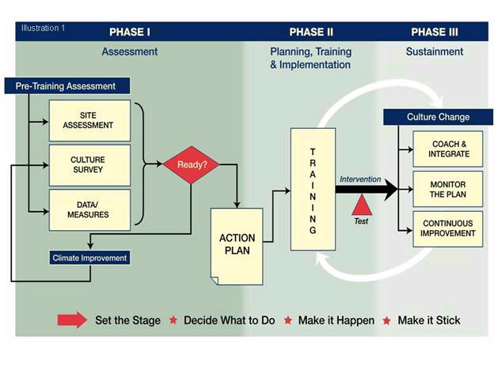
TeamSTEPPS Phases
Requires
Measurement

Slide 4
Importance of Accurate Measurement

Slide 5
How to Measure - Kirkpatrick
Level 4 Results
Level 3 Behaviors
Level 2 Learning
Level 1 Reactions
Measure examples:
Specific measures
Data examples:
Organizational results
Changed actions, processes
Transfer to their job
Survey learners for planned
changes, understanding
Learners think, feel, do
Survey learners for opinions
Satisfaction, Usefulness

Slide 6
Available Measures
Reactions
Course Evaluation Form
Learning
Teamwork Attitudes Questionnaire (T-TAQ)
Learning Benchmarks
Team Performance Observation Tool
Teamwork Perceptions Questionnaire (T-TPQ)
Behavior
Team Performance Observation Tool
Teamwork Perceptions Questionnaire (T-TPQ)
AHRQ Surveys on Patient Safety Culture
Results
Patient outcome and clinical process measures
AHRQ Surveys on Patient Safety Culture
Patient Safety Indicators

Slide 7
AHRQ Surveys on Patient Safety Culture
Free, easy-to-use surveys to assess patient safety culture
Available for various contexts:
Hospital
Medical Office
Nursing Home
Pharmacy
Available at http://www.ahrq.gov/

Slide 8
Hospital Survey on Patient Safety Culture
Level III Behavior and Level IV Results
Composed of 51 items and 12 composites
Comprehensive instrument that assesses staff perceptions of patient safety culture
Hospitalwide
Specific work area or unit
Comparative database
Voluntarily submitted data from U.S. hospitals

Slide 9
How Can Hospitals Use the Survey on Patient Safety Culture?
Raise awareness about patient safety issues
Assess patient safety culture
Track changes in patient safety culture over time
Evaluate the impact of patient safety interventions (e.g., TeamSTEPPS)

Slide 10
Survey Measures: 12 Areas of Patient Safety and Two Overall Items
Unit-level safety areas
Hospitalwide safety areas
Hospital management support for patient safety
Teamwork across hospital units
Hospital handoffs and transitions
Overall perceptions of safety
Frequency of events reported
Supervisor/manager expectations and actions promoting safety
Organizational learning—continuous improvement
Teamwork within units
Communication and openness
Feedback and communication about error
Nonpunitive responses to error
Staffing
Overall items
The patient safety “grade” respondents would assign their work area/unit
The number of events the respondent reported in the last 12 months

Slide 11
What Support Is Available?
Hospital Survey Toolkit
Survey forms
Survey items and dimensions
Survey User’s Guide
Survey feedback report template
Data entry and analysis tool
Comparative database and reports
http://www.ahrq.gov/professionals/quality-patient-safety/patientsafetyculture/index.html

Slide 12
AHRQ Patient Safety Indicators (PSIs)
Level IV Results
Provide information on potential in-hospital complications and adverse events
Can help identify potential adverse events that might need further study
Include indicators for in-hospital complications that may represent patient safety events
http://www.qualityindicators.ahrq.gov/

