Slide 1
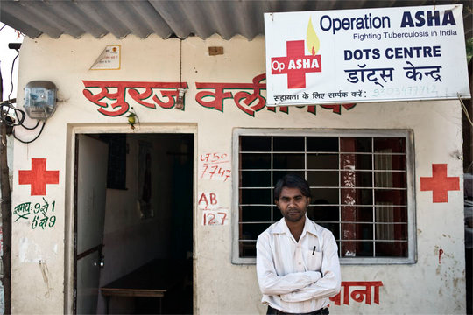
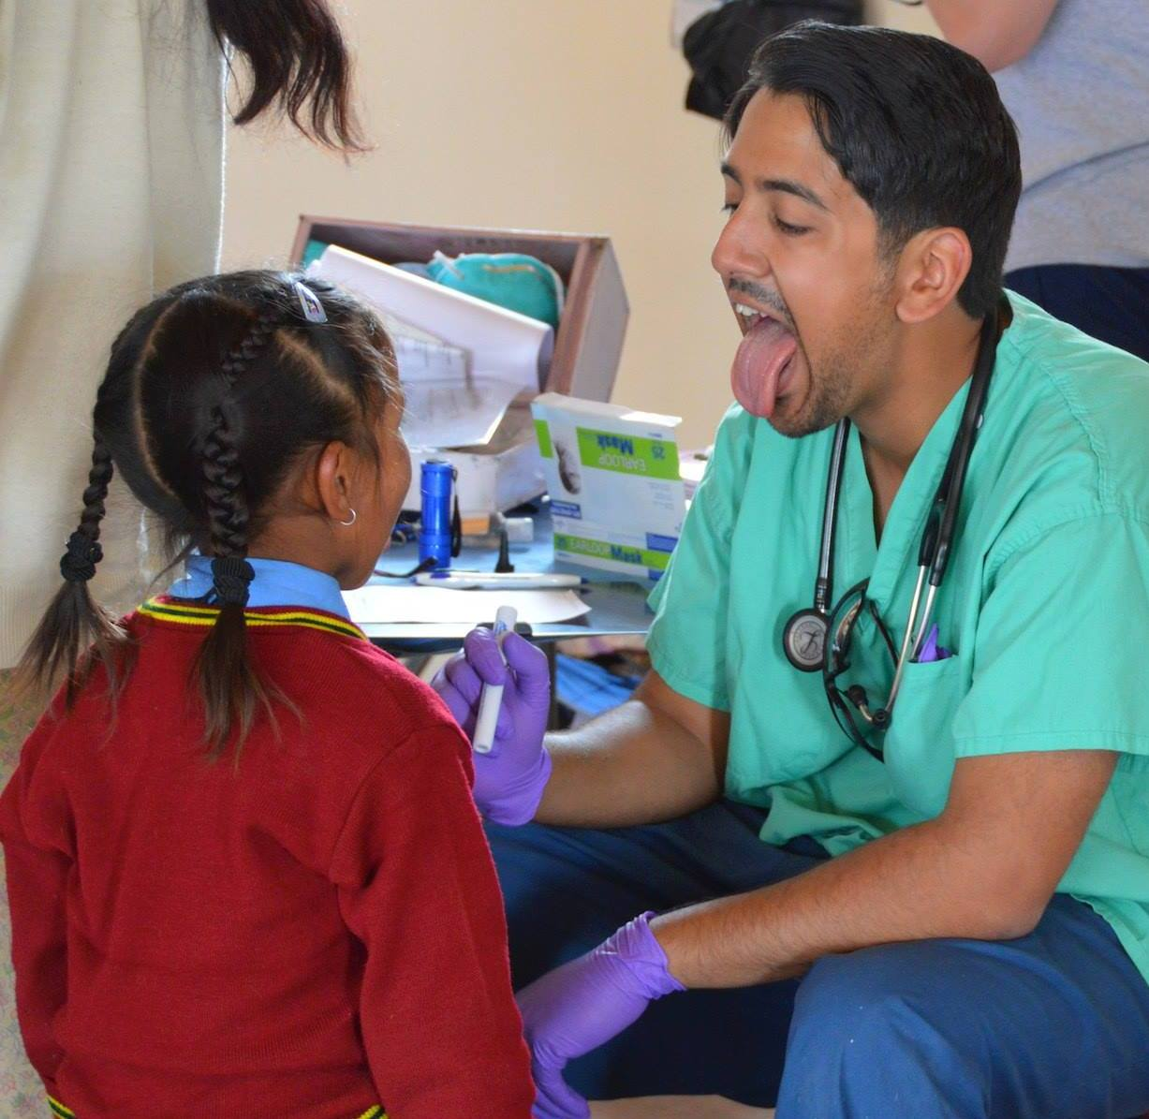
Multi-Drug Resistant Tuberculosis in Ladakh: Challenges to Treatment
Adi Kulkarni
Office of Global Health, Rutgers Robert Wood Johnson Medical School, Piscataway, NJ 08854
Introduction
India has the highest burden of tuberculosis in the world, with an estimated 2 million cases annually, accounting for 1/5th of global incidence
MDR-TB is defined as tuberculosis that is resistant to treatment with both Isoniazid (INH) and Rifampacin (RIF)
In 2010, the overall prevalence of MDR-TB in Northern India was 40.8%. Increasing from 36.4% in 2007
Directly-Observed Treatment Short-course (DOTS) is the standard of care for TB and MDR-TB
India adopted the DOTS program in 1997
Treatment with DOTS
DOTS has 5 key components
Political commitment to control TB
Case detection by sputum smear microscopy in symptomatic patients
Patients are given anti-TB drugs under the direct observation of a healthcare provider/community DOTS provider
Regular, uninterrupted supply of anti-TB drugs
Systematic recording and reporting system that allows assessment of treatment results for each and every patient and the whole TB control program
Purpose
MDR-TB is a significant problem in Northern India that needs to be addressed
Examine treatment strategies currently in place for the treatment of TB and MDR-TB in Northern India
Identify and address the challenges to treating MDR-TB in India, and specifically the Ladakh region of Northern India
Trends of leprosy prevalence (PR) and annual new case detection (ANCDR)
Traditional treatments
73.2% of Ladhaki’s expressed a strong belief in the amchi system of traditional healing, and persists even among those who are not cured
Challenges to DOTS
Poor primary care infrastructure in rural areas of the state
Unregulated private healthcare, leading to improper use of TB-medication
Spreading HIV infection
Lack of political will
Political corruption
Methods
The Himalayan Health Exchange travelled to the Ladakh region of the Indian state of Jammu and Kashmir, and treated approximately 1,000 patients
A record of patient diagnoses and treatment plans was maintained over the 9 clinic days
No patients presented outright with MDR-TB infection, although 5 patients did report prior infection with TB or cases of extra-pulmonary
During the 2011 trip, 4 confirmed cases of TB were reported along with 2 possible cases
References
Gupta, A., MR Nagaraja, P. Kumari, G. SIngh, R. Raman, SK Singh, and S. Anupurb. "Association of MDR-TB Isolates with Clinical Characteristics of Patients from Northern Region of India."Indian Journal of Medical Microbiology 32.3 (2014): 270-76. Web.
Maurya, AK, AK Singh, M. Kumar, J. Umrao, S. Kant, and VL Nag. "Changing Patterns and Trends of Multidrug-resistant Tuberculosis at Referral Centre in Northern India: A 4-year Experience."Indian Journal of Medical Microbiology. N.p., 15 Mar. 2013. Web.
Mobar, Sonal. "Dynamics of Treatment Adherence: A Study of TB Infected People of Leh, Ladakh." International Proceedings of Economics Development and Research 51.6 (2012): 21-25. Web.
"Revised National TB Control Programme (RNTCP)." Revised National TB Control Programme (RNTCP). N.p., n.d. Web. 25 Oct. 2014.
Sandhu, Gursimratk. "Tuberculosis: Current Situation, Challenges and Overview of Its Control Programs in India." Journal of Global Infectious Diseases 3.2 (2011): 143. Web.
"TB in India | RNTCP, TB Care & Drug Resistant TB." TB in India. N.p., n.d. Web. 25 Oct. 2014.
Supported by:
The Office of Global Health, Rutgers Robert Wood Johnson Medical School

