Slide 1
Annual Global Health Fair
Beyond Borders: Faculty Journeys in Global & Glocal Health
December 3, 2025

Slide 2
Annual Global Health Fair
Agenda
I
5:00 pm Welcome and Opening Remarks
Karen W. Lin, MD, MS, FAAFP
II
5:15 pm Panel Discussion with Q&A Moderated by Angela Gitau MD
Panelists: James K. Aikins Jr, MD, FACOG, FACS; Charletta Ayers, MD, MPH; Janelle Billig, MD;
Sabiha Hussain, MD,MPH; Karen W. Lin, MD, MS, FAAFP; and Harsh Sule, MD, MPP
III
6:35 pm Closing Remarks
Karen W. Lin, MD, MS, FAAFP
Rutgers Global Partnerships in India, South Korea, and Ghana.
IV
7:00 pm Poster Presentations
Faculty, students, and staff will present their Global Health experiences and research through posters.
v
8:00 pm End of Program
Notes:
One Column Agenda
The Roman numerals can be changed to regular numbers
Add time for each topic
Add your topic in bold font
Add your supporting text in italics

Slide 3
Beyond Borders: Faculty Journeys in Global & Glocal Health
This year’s faculty panel, Beyond Borders: Faculty Journeys in Global & Glocal Health, will highlight the experiences of colleagues engaged in international and local-global (“glocal”) health initiatives, research collaborations, and mission-driven projects. Our goal is to showcase the breadth of faculty engagement, share lessons learned, and inspire students and residents interested in this field.
Discussion topics will include:
  Personal journeys into global or gLocal health
  Building equitable partnerships abroad and locally
  Lessons from emerging issues in the past two years (e.g., climate change, conflict, health equity, digital health)
  Guidance for students and residents interested in global health pathways

Slide 4
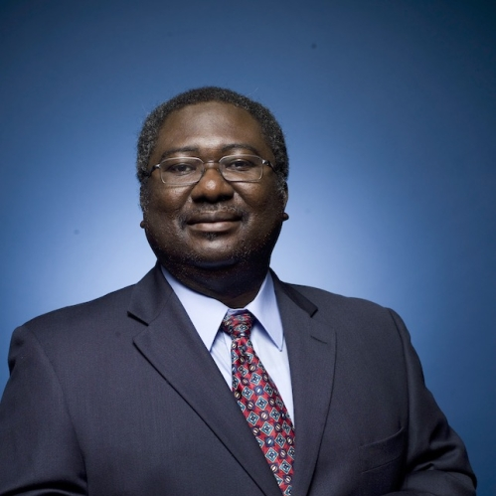
James K. Aikins Jr., MD, FACOG, FACS
Chief, Gynecologic Oncology Division
Director, Gynecologic Oncology Fellowship Program
Associate Professor Department of Obstetrics, Gynecology, and Reproductive Sciences
Rutgers Cancer Institute
Ghana
Leads Rutgers Cancer Institute’s multidisciplinary Gynecologic Oncology Program, which offers advanced treatment options including minimally invasive surgical techniques, clinical trials, precision medicine, and immunotherapy.
Co-Founder and Medical Director of International Healthcare, whose mission is to provide sustainable programs and medical services to underserved women and their families living in Ghana, West Africa, and to provide continuing medical education for health professionals, including students at Robert Wood Johnson Medical School. Conducts global health research in the area of cervical cancer screening in low-resource communities. He currently serves as a visiting professor at Cape Coast Teaching Hospital in the OB/GYN Department (University of Cape Coast School of Medical Sciences) in Cape Coast, Ghana, West Africa.
https://youtu.be/NoNajQwEEc0

Slide 5
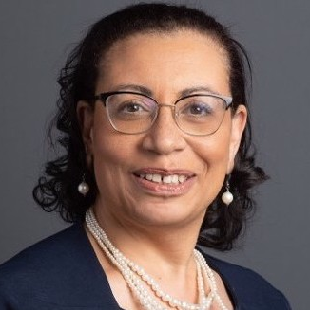
Charletta Ayers, MD, MPH
Assistant Dean of Multicultural Affairs
Associate Professor and Vice Chair of Clinical Affairs
Department of Obstetrics, Gynecology, and Reproductive Sciences
Ghana
A member of the faculty since 1993, has extensive experiences in research and clinical service here at RWJMS. Integral in the education and mentorship of medical undergraduate and graduate scholars. Mentor for local and international Global Health projects.
Co-Founder, & Chair of the Board for International HealthCare Volunteers, whose mission is to provide sustainable programs and medical services to underserved women and their families living in Ghana, West Africa. She serves as a Visiting OB/GYN Specialist and Lecturer at Cape Coast Teaching Hospital and is a Fellow of the Ghana College of Physicians and Surgeons. She is also affiliated with the Ghana Physicians & Surgeons Foundation of North America and collaborates with RWJMS through its Women’s Health/One Health initiatives. Her leadership includes Rutgers Mandela Washington Fellowship Faculty Research Mentor, directing a Global/Urban Women’s Health Fellowship for junior faculty development, overseeing a gynecologic surgical simulation program in Ghana, and coordinating a joint global health journal club between Cape Coast Regional Hospital and RWJ Medical School.

Slide 6

International Health Care Volunteers (IHCV)
International Health Care Volunteers (IHCV), a U.S.-based non-profit organization, continues its longstanding commitment to improving healthcare access for women and families in underserved regions. Through clinical service, mentorship, and education, IHCV works to strengthen healthcare capacity alongside local institutions. In the following countries Ghana, Jamaica and Dominican Republic. . IHCV has provided care to over 14, 000 individuals and in it’s 23rd yr. https://www.ihcv.org/
In collaboration with the College of Physicians and Surgeons of Ghana, and Cape Coast Teaching Hospital the Ghana Ministry of Health, and local communities, IHCV provides ongoing training and simulation-based education to junior physicians, residents, nurses, and medical students. Its initiatives include
  Capacity building and multi-disciplinary continuing medical education in
    Obstetric Emergencies
    Minimally invasive surgery across specialties such as gynecology, gynecology oncology, urology, and vascular surgery.
    Cervical cancer screening
    Journal clubs
  Community Outreach
    Menstrual Health Symposium
    Community Blood Pressure Screening
    Support Local Orphanages
    Maternal Pediatrics Care Packages

Slide 7
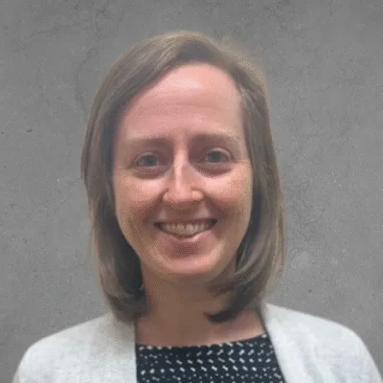
Janell Billig, MD
Clinical Assistant Professor, Family Medicine & Community Health
Tanzania
Influenced by an inspiring friend from Malawi, she became interested in supporting medical education development in the East Africa region and had some experiences there as a student and resident, which focused on supporting the launch of the country’s first family medicine residency. After residency in 2016, she joined the US Peace Corps program called Global Health Service Partnership, where she was partnered with Tanzanian medical school faculty at the University of Dodoma for 2 years full-time. In addition to classroom and bedside teaching, she supported the growth of the young medical school through educational technology capacity projects, simulation learning programs, and faculty development efforts. She has continued to stay involved over the past 9 yrs through virtual teaching support, periodic visits, and hopes to strengthen a partnership between Rutgers and the University of Dodoma to enable further growth of medical education in Tanzania through collaboration and exchange.
University of Dodoma: https://www.udom.ac.tz/

Slide 8
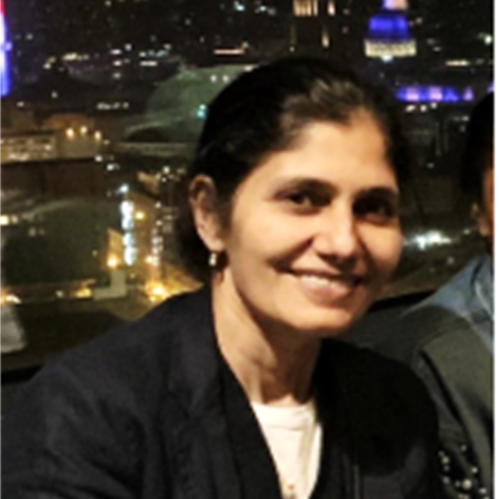
Sabiha Hussain MD MPH
Professor of Medicine Division of Pulmonary and Critical Care, Vice Chair, Pulmonary and Critical Care Fellowship
Director of Adult Cystic Fibrosis Program
Director of the Long COVID program
Director of Your Health Kiosk
Brazil, Dominican Republic, India, Romania & Taiwan
Leads several global health initiatives focused on pulmonary health and environmental justice. These include a reforestation and air-quality project in Delhi, India—conducted in partnership with the U.S. Department of Forestry and local NGOs—to reduce pollution and correlate improvements in air quality with key health outcomes. She is also developing a culturally responsive pulmonary health curriculum with partners in Brazil, Rutgers schools, and the New Labor community organization to improve health literacy among vulnerable populations in New Brunswick. In addition, she is creating a Global Health track within the Pulmonary and Critical Care Fellowship to expand international clinical and research opportunities. These ongoing projects, active for over a year, span multiple regions including India, the United States, Brazil, the Dominican Republic, and Romania. Mentor’s local students, residents and fellows and regularly host international medical students with an interest in internal medicine.

Slide 9
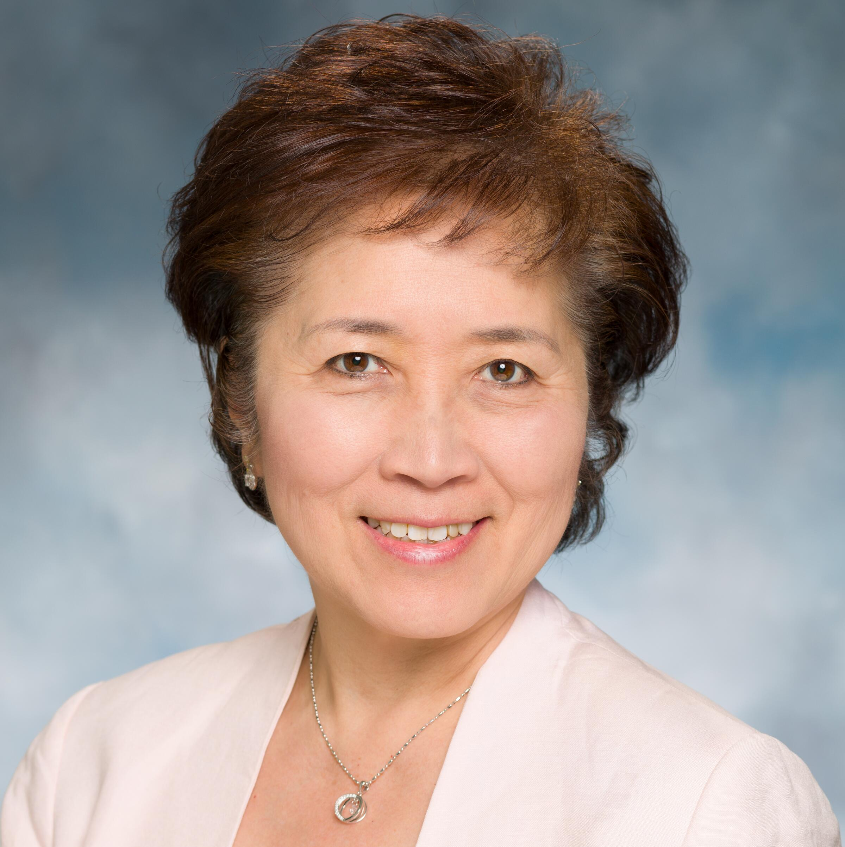
Karen W. Lin, MD, MS, FAAFP
Associate Dean Global Health
Professor of Family Medicine and Community Health
Director, Center for Healthy Families and Cultural Diversity
Faculty Advisor, HIPHOP-Promise Clinic & Asylum Clinic
Ethiopia, China, Japan, Taiwan, Tanzania
She has been part of Rutgers and RWJMS for over 20 years as a student and now a faculty member. She joined the Office of Global Health as Assistant Dean from 2011 to 2022 and now serves as Associate Dean, where she has been instrumental in expanding institutional partnerships, particularly in China, Japan, Taiwan, and Tanzania. She has led physician, nursing, pharmacy, and administrative exchanges between partner institutions, facilitating the sharing of knowledge and best practices. She also served as a Fulbright Specialist at partner institutions in Japan and Taiwan. In addition, she plays a key role in advancing the global health agenda through her work with the Mandela Washington Fellows Program, her participation on the Global Health Task Force, and her role as Core Faculty with the Rutgers Global Health Institute.
At RWJMS, she holds numerous leadership and advisory positions, including Faculty Advisor for the HIP-HOP Promise Clinic, the Medical Mandarin elective, the Complementary and Alternative Medicine elective, the Asian Pacific American Medical Student Association, the Global Health Interest Group, and Physicians for Human Rights. In her role as Associate Dean for Global Health, she also serves as Co-Director and mentor for the Distinction in Global Health (DIGH) program, a faculty mentor to international medical students, and a course co-director for an elective offered in collaboration with RSGSBM.
Within the community, she serves as a physician advisor for RWJUH Community Health Promotion, is a member of the RWJUH Community Relations Committee, and acts as an advisor to the Piscataway Township Health Advisory Commission.
https://www.youtube.com/watch?v=PPd457Jhip8

Slide 10
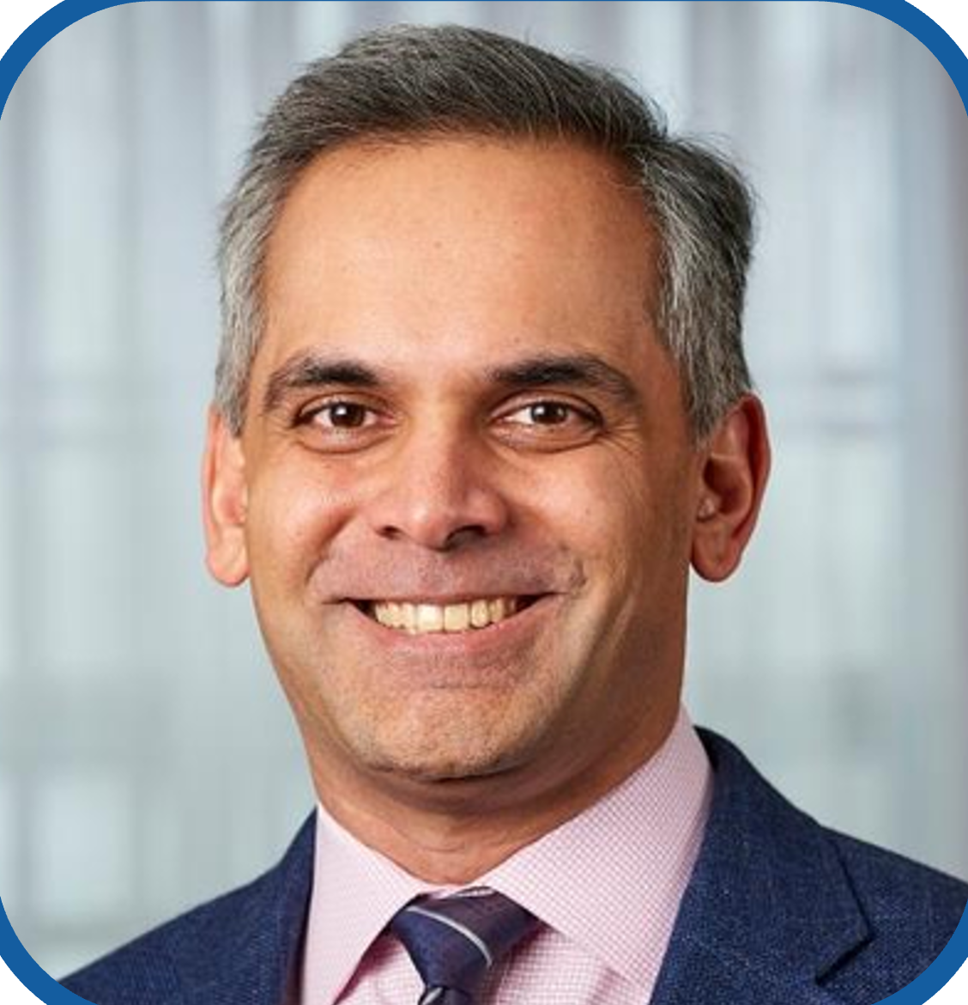
Harsh Sule, MD, MPP
Chair (Interim) & Professor of Emergency Medicine
Vice-Chair for Academic Affairs
Associate Director, Office of Global Health
GhanA, Sierra Leone, Azerbaijan
A board-certified emergency physician and also has a Master in Public Policy from Princeton University. In addition to working clinically, he is active in medical education and global health.
Active in global health for over 15 years. His prior work includes projects in Sierra Leone and Azerbaijan. With International Medical Corps in Azerbaijan, he worked on an emergency medicine development project and then served as its Country Director. At Rutgers NJMS, Dr. Sule has taken on a lead role in advancing the global health agenda via participation in the Global Health Task Force, serving as a liaison to the greater Rutgers global health community and is Core Faculty with the Rutgers Global Health Institute. His current work in Ghana includes in-country educational initiatives such as a disaster management course and a point-of-care ultrasound course, as well as weekly virtual interactive medical case conferences. The work in Ghana is in partnership with Tetteh Quarshie Memorial Hospital (Mampong-Akuapem), the Ghana College of Physicians and Surgeons, Society of Family Physicians of Ghana and the University of Cape Coast.
https://njms.rutgers.edu/education/odace/office_global_health/index.php

Slide 11
Resources
Global and Local Health at Rutgers
Rutgers Global
Asylum Clinic
Rutgers Global Health Institute
Healthier New Brunswick
Women’s Health Institute
South Asian Total Health Initiative
One Health
NJMS Office of Primary Care and Community Engagement

Slide 12
Thank you!
Email any questions to your globalhealth@rwjms.rutgers.edu
For more information, visit:
https://rwjms.rutgers.edu/about/office-global-health/fair
Brought to you by
Office of Global Health
Rutgers Health,
Robert Wood Johnson Medical School

